Slide 1
Expanding Horizons for Resolution Professionals & Registered Valuers
Organizer: (ICSI IIP), (ICSI RVO), (IPA ICAI-Cost), (ICMAI RVO) with (IBBI)
Date : 08.08.2018
Venue : PUNE

Slide 2
Resolution Professional – Ex..Ho..
Pre IBC Era
Dr. Ajay Garg
Corporate Lawyers and R. Valuer

Slide 3
Resolution Professional – Ex..Ho..
Core Scope of Work 1:
RP and IRP
Dr. Ajay Garg
Corporate Lawyers and R. Valuer

Slide 4
Resolution Professional – Ex..Ho..
Core Scope of Work 2:
Company Liquidator
Dr. Ajay Garg
Corporate Lawyers and R. Valuer

Slide 5
Resolution Professional – Ex..Ho..
As Representative of Home Buyers
Dr. Ajay Garg
Corporate Lawyers and R. Valuer

Slide 6
Resolution Professional – Ex..Ho..
Representative Services in COC
Dr. Ajay Garg
Corporate Lawyers and R. Valuer

Slide 7
Resolution Professional – Ex..Ho..
Advisory Services to Various Stakeholders
Dr. Ajay Garg
Corporate Lawyers and R. Valuer

Slide 8
Resolution Professional – Ex..Ho..
Filing of Claims
Dr. Ajay Garg
Corporate Lawyers and R. Valuer

Slide 9
Resolution Professional – Ex..Ho..
Registration with NeSL
Dr. Ajay Garg
Corporate Lawyers and R. Valuer

Slide 10
Resolution Professional – Ex..Ho..
Preparation of Resolution Plan
Dr. Ajay Garg
Corporate Lawyers and R. Valuer

Slide 11
Resolution Professional – Ex..Ho..
Execution of Approved Resolution Plan
Dr. Ajay Garg
Corporate Lawyers and R. Valuer

Slide 12
Resolution Professional – Ex..Ho..
Bankruptcy Trustee : Just on Cards
Dr. Ajay Garg
Corporate Lawyers and R. Valuer

Slide 13
Resolution Professional – Ex..Ho..
SEBI Regulations
Specific regulation for SEBI (Appointment of Administrator and Procedure for refunding to the Investors) Regulations, 2018
Dated: 3rd October, 2018
Dr. Ajay Garg
Corporate Lawyers and R. Valuer

Slide 14
Registered Valuer – Ex..Ho..
Pre RV Era about to End on 31.01.2019
Dr. Ajay Garg
Corporate Lawyers and R. Valuer

Slide 15
Registered Valuer – Ex..Ho..
Section 247, Rules and PCC
Dr. Ajay Garg
Corporate Lawyers and R. Valuer

Slide 16
Registered Valuer – Ex..Ho..
Expanding Horizon- Co’s Act, 2013
Further Issue of Shares (other than Right Issue):
Private Placement of Shares [Section 62(1)(c)];
Issue of Shares in Preferential basis [Section 62(1)(c)];
Issue of Share for consideration other than cash [Section 62(1)(c)]
Issue of shares under a Scheme of Employee Stock Option under the provisions of [Section 62(1)(c)]
Dr. Ajay Garg
Corporate Lawyers and R. Valuer

Slide 17
Registered Valuer – Ex..Ho..
Expanding Horizon- Co’s Act, 2013
Non cash transaction involving directors [Section 192(2)]
Dr. Ajay Garg
Corporate Lawyers and R. Valuer

Slide 18
Registered Valuer – Ex..Ho..
Expanding Horizon- Co’s Act, 2013
Merger and Amalgamations [Section 230(2)]
Dr. Ajay Garg
Corporate Lawyers and R. Valuer

Slide 19
Registered Valuer – Ex..Ho..
Expanding Horizon- Co’s Act, 2013
Demergers [Section 230(2)]
Dr. Ajay Garg
Corporate Lawyers and R. Valuer

Slide 20
Registered Valuer – Ex..Ho..
Expanding Horizon- Co’s Act, 2013
Scheme of compromise or arrangement with members [Section 230(2)]
Dr. Ajay Garg
Corporate Lawyers and R. Valuer

Slide 21
Registered Valuer – Ex..Ho..
Expanding Horizon- Co’s Act, 2013
Scheme of compromise or arrangement with creditors [Section 230(2)]
Dr. Ajay Garg
Corporate Lawyers and R. Valuer

Slide 22
Registered Valuer – Ex..Ho..
Expanding Horizon- Co’s Act, 2013
Submission of report by company liquidator [Proviso to Section 281(1)(a)]
Dr. Ajay Garg
Corporate Lawyers and R. Valuer

Slide 23
Registered Valuer – Ex..Ho..
Expanding Horizon- Co’s Act, 2013
Purchase of minority shareholding [Section 236(2)]
Dr. Ajay Garg
Corporate Lawyers and R. Valuer

Slide 24
Registered Valuer – Ex..Ho..
Ex..Ho.. IBC, 2016
On Insolvency Commencement Date
Dr. Ajay Garg
Corporate Lawyers and R. Valuer

Slide 25
Registered Valuer – Ex..Ho..
Expanding Horizon- IBC, 2016
On Liquidation Commencement Date
Dr. Ajay Garg
Corporate Lawyers and R. Valuer

Slide 26
Registered Valuer – Ex..Ho..
Expanding Horizon- IBC, 2016
On Initiation of VWU
Dr. Ajay Garg
Corporate Lawyers and R. Valuer

Slide 27
Registered Valuer – Ex..Ho..
Expanding Horizon-
SEBI Regulations
Specific regulation for SEBI ( Appointment of Administrator and Procedure for refunding to the Investors) Regulations, 2018 dated 3rd October, 2018
SEBI (Real Estate Investment Trusts) Amendment Regulations, 2017 dated 15th December, 2017
Dr. Ajay Garg
Corporate Lawyers and R. Valuer

Slide 28
Registered Valuer – Ex..Ho..
Expanding Horizon-
Stamp Duty Act
Dr. Ajay Garg
Corporate Lawyers and R. Valuer

Slide 29
Registered Valuer – Ex..Ho..
Expanding Horizon-
Unincorporated Entities
Dr. Ajay Garg
Corporate Lawyers and R. Valuer

Slide 30
Registered Valuer – Ex..Ho..
Expanding Horizon- Debt Funding
Dr. Ajay Garg
Corporate Lawyers and R. Valuer

Slide 31
Registered Valuer – Ex..Ho..
Expanding Horizon - Quasi Equity
Dr. Ajay Garg
Corporate Lawyers and R. Valuer

Slide 32
Registered Valuer – Ex..Ho..
Expanding Horizon –
SEBI Regulations
Dr. Ajay Garg
Corporate Lawyers and R. Valuer

Slide 33
Registered Valuer – Ex..Ho..
Expanding Horizon –
Income Tax Act, 1961
Dr. Ajay Garg
Corporate Lawyers and R. Valuer

Slide 34
Registered Valuer – Ex..Ho..
Expanding Horizon - FEMA 2000
Dr. Ajay Garg
Corporate Lawyers and R. Valuer

Slide 35
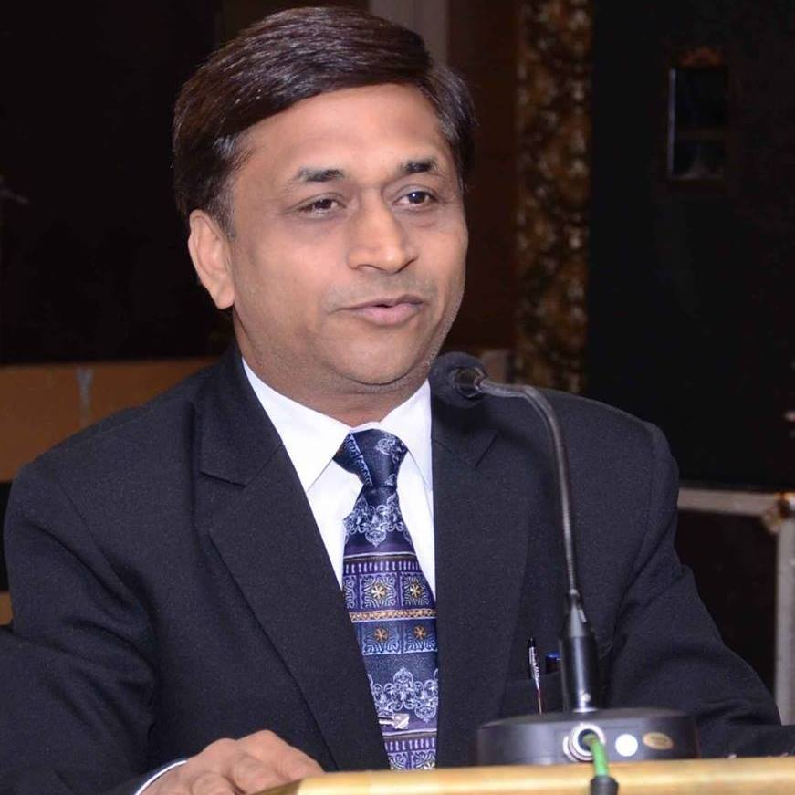
Thank You
Contact Detail:
Dr. Ajay Garg
gargajay24@yahoo.co.in
M.No. +91- 9811386723

