Slide 1
Individual insolvency
Kanika kitchlu-Connolly
Prashan Patel
26 NOVEMBER 2018

Slide 2
Kanika kitchlu-connolly
Director
Kanika's practice covers general commercial litigation matters with a focus on contentious insolvency, fraud and asset recovery, often within an international and cross-border context. Kanika deals with both corporate and personal insolvencies and her breadth of knowledge and experience of recovery options, with particular reference to insolvency, ensures that she is able to apply pressure, as and when necessary, to obtain the right results.
Kanika's main client base is insolvency practitioners but she also acts for directors of companies, advising them in relation to their duties as regards the company's creditors and shareholders.
More recently, Kanika has been turning her attention to the Indian Insolvency and Bankruptcy Code 2016 gaining an in-depth understanding of the legislation, its mechanics and challenges.
Kanika has recently been recognised as a “recommended” lawyer in the Corporate Restructuring and Insolvency space in the Legal 500 directories.
E Kanika.kitchlu-connolly@gowlingwlg.com T +44 (0)20 7759 6789

Slide 3
SPEAKER
Prashan Patel
Associate Director
Prashan has spent the last several years working on a number of high profile insolvencies, both corporate and personal, and specialises in international asset tracing, recovery and enforcement. He uses insolvency and civil procedures as powerful tools to recover hidden assets from a number of jurisdictions including, Europe, the offshore financial centres, Asia, the Caribbean, USA and the Middle East.
He has extensive experience structuring recovery strategies that involve funding, often sharing the cost and reward of recovery with his clients. His team has recovered over £3 billion worth of assets globally in the last eight years.
Recently, Prashan has been working in conjunction with Grant Thornton India to help grow and develop its restructuring, insolvency and asset recovery business in light of recent legislative changes in India. The recovery of assets related to Indian fraud or bad debts outside of the jurisdiction is a particular interest and focus of his.
E Prashan.p.patel@uk.gt.com T +44 (0)20 7865 2328

Slide 4
Individual insolvency - Agenda
Recent statistics
Applicable legislation in England and Wales
Timeline of a bankruptcy
The Petition
Appointment of Trustee
Vesting of assets
Investigations and claims
Discharge
Impact of bankruptcy on the bankrupt
Use of technology
Obstacles / challenges

Slide 5
Recent statistics
The Insolvency Service produces a public report every quarter
Up to Q3 2018:
Individual insolvencies totalled 25,151
IVAs: 55.8%
DRO: 27.7%
Bankruptcies: 16.5%

Slide 6
Applicable legislation in E&W
Legislation | Best Practice/ Guidance
Insolvency Act 1986 | Statement of Insolvency Practice
EC Regulation on Insolvency Proceedings 2000 / 2015 | Guidance from relevant Regulatory Bodies
Enterprise Act 2002
Cross Border Insolvency Regulations 2006
Small Business, Enterprise and Employment Act 2015
Insolvency (England and Wales) Rules 2016
Practice Direction on Insolvency Proceedings 2018

Slide 7
Timeline of a bankruptcy
Life of individual
Bankruptcy order
Insolvency estate
Personal assets
Tools of trade
Pension
- Assets (excluding essentials)
- Liabilities
Interview with OR
Official Receiver
Bankrupt individual
Statement of assets and liabilities
IP appointed as trustee?
Lives and works subject to restrictions and duties
Income payments for 3 years
After acquired property (until discharged and subject to trustee giving notice)
Administer estate, investigate, realise assets and distribute to creditors
1 Year
Automatic discharge
Interest in home returned to individual if unrealised after 3 years
Final report and trustee vacates office

Slide 8
Timeline of a bankruptcy
Petition
Type of debtors
Who can petition?
Cost
Pre-requisites
Statutory demand
Personal service
Undisputed debt over relevant thresholds

Slide 9
The Appointment
Life of individual
Bankruptcy order
Insolvency estate
Personal assets
Tools of trade
Pension
- Assets (excluding essentials)
- Liabilities
Interview with OR
Official Receiver
Bankrupt individual
Statement of assets and liabilities
IP appointed as trustee?
Lives and works subject to restrictions and duties
Income payments for 3 years
After acquired property (until discharged and subject to trustee giving notice)
Administer estate, investigate, realise assets and distribute to creditors
1 Year
Automatic discharge
Interest in home returned to individual if unrealised after 3 years
Final report and trustee vacates office

Slide 10
The appointment
Official Receiver initially appointed over all cases
Non-contested straightforward cases
Cooperative bankrupt
Appointment of private trustee
Contested cases where more complex investigations are required
Cross border
Often uncooperative bankrupts

Slide 11
The appointment (2)
Duties of a Trustee
Section 305 IA 1986
“…get in, realise and distribute the bankrupt’s estate in accordance with the following provisions of this Chapter and in the carrying out of that function and in the management of the bankrupt’s estate the trustee is entitled…to use his own discretion”

Slide 12
The appointment (3)
Notification to creditors throughout the bankruptcy
Online portals
Virtual meetings
Possible issues
Creditors’ committee
Insurance considerations
Statutory reporting requirements

Slide 13
Vesting of assets
Life of individual
Bankruptcy order
Insolvency estate
Personal assets
Tools of trade
Pension
- Assets (excluding essentials)
- Liabilities
Bankrupt individual
Interview with OR
Official Receiver
Statement of assets and liabilities
IP appointed as trustee?
Lives and works subject to restrictions and duties
Income payments for 3 years
After acquired property (until discharged and subject to trustee giving notice)
Administer estate, investigate, realise assets and distribute to creditors
1 Year
Automatic discharge
Interest in home returned to individual if unrealised after 3 years
Final report and trustee vacates office

Slide 14
Vesting of assets
Assets that vest
Automatic vesting
Dwelling house – 3 year rule
Assets that don’t vest
Tools of the trade
Pension pots
ISA Accounts

Slide 15
Investigations and claims
Life of individual
Bankruptcy order
Insolvency estate
Personal assets
Tools of trade
Pension
- Assets (excluding essentials)
- Liabilities
Interview with OR
Official Receiver
Bankrupt individual
Statement of assets and liabilities
IP appointed as trustee?
Lives and works subject to restrictions and duties
Income payments for 3 years
After acquired property (until discharged and subject to trustee giving notice)
Administer estate, investigate, realise assets and distribute to creditors
1 Year
Automatic discharge
Interest in home returned to individual if unrealised after 3 years
Final report and trustee vacates office

Slide 16
Investigations and claims
Statutory Powers of trustees
Powers exercised without sanction
Powers exercised with sanction
Investigatory powers
Obtaining information/documents
Compelling third parties to cooperate
After acquired property
IPA/IPO
Antecedent transactions

Slide 17
Investigations and claims (2)
Foreign Bank
Company
Owner (UK Bankruptcy)
Company #2 (BVI)
Company #1 (BVI)
Italian Yacht
INR 10 crores
Italian Personal Property
INR 100 crores
Company #3 (Cyprus)
Company #4 (Germany)
Company #5 (Cyprus)
Cypriot Assets
INR 60 crores
Italian Assets
INR 50 crores
German Assets
INR 20 crores

Slide 18
Investigations and claims (3)
Powers of the court
Arrest
Seizure of property
Public/private examination
Mail and e-mail redirection
Suspension from discharge
Mutual assistance between courts

Slide 19
Discharge
Life of individual
Bankruptcy order
Insolvency estate
Personal assets
Tools of trade
Pension
- Assets (excluding essentials)
- Liabilities
Interview with OR
Official Receiver
Bankrupt individual
Statement of assets and liabilities
IP appointed as trustee?
Lives and works subject to restrictions and duties
Income payments for 3 years
After acquired property (until discharged and subject to trustee giving notice)
Administer estate, investigate, realise assets and distribute to creditors
1 Year
Automatic discharge
Interest in home returned to individual if unrealised after 3 years
Final report and trustee vacates office

Slide 20
discharge
Automatic discharge after 12 months
Suspension of automatic discharge
Court application
Can be indefinite
Trustee remains in office despite discharge

Slide 21
Impact of bankruptcy on the bankrupt
Life of individual
Bankruptcy order
Insolvency estate
Personal assets
Tools of trade
Pension
- Assets (excluding essentials)
- Liabilities
Interview with OR
Official Receiver
Bankrupt individual
Statement of assets and liabilities
IP appointed as trustee?
Lives and works subject to restrictions and duties
Income payments for 3 years
After acquired property (until discharged and subject to trustee giving notice)
Administer estate, investigate, realise assets and distribute to creditors
1 Year
Automatic discharge
Interest in home returned to individual if unrealised after 3 years
Final report and trustee vacates office

Slide 22
Impact of bankruptcy on the bankrupt
Duty of cooperation
Prohibition from acting as a director
Availability of credit lines
Bank accounts frozen
Criminal offence

Slide 23
Use of Technology
CE Court filing
Telephone hearings and applications on paper
Companies House
Experian searches
Land Registry and Land Charges searches
Individual Insolvency Register

Slide 24
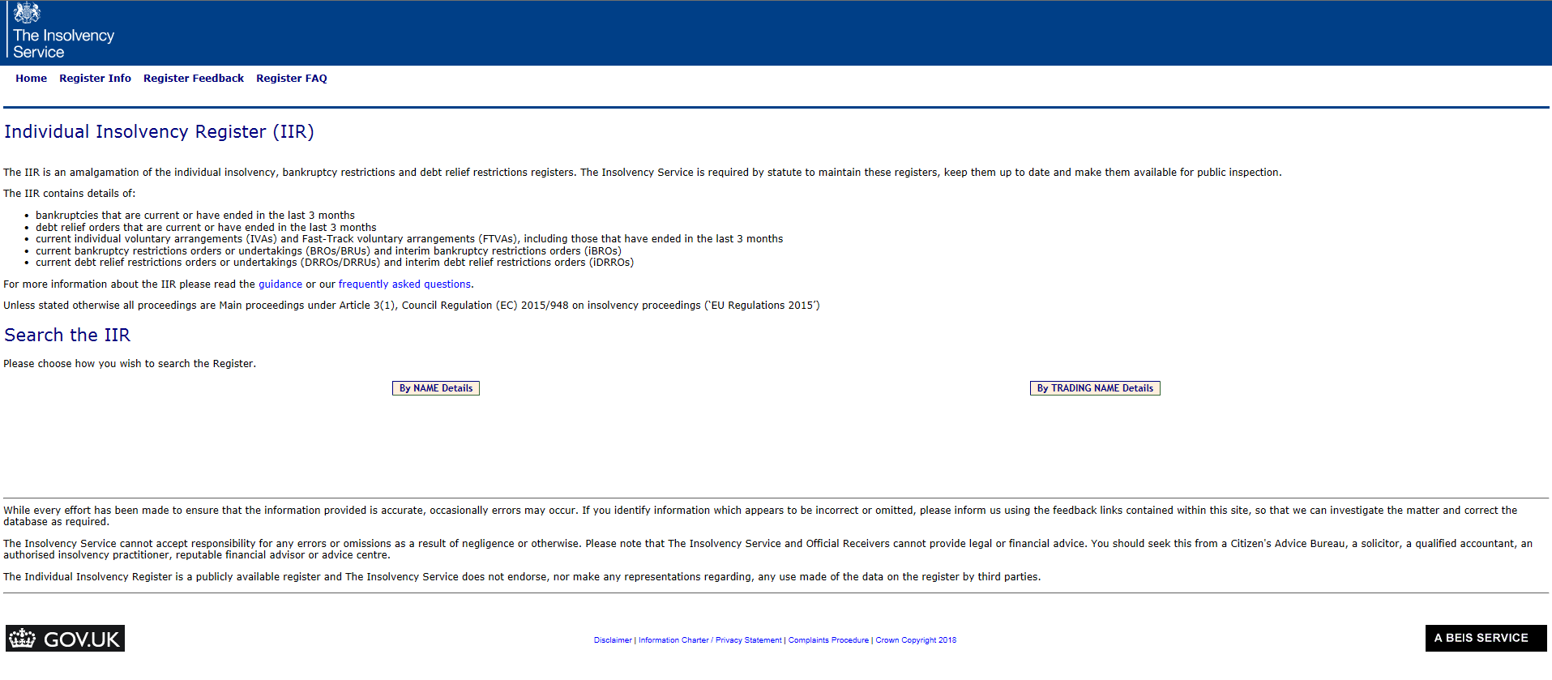

Slide 25
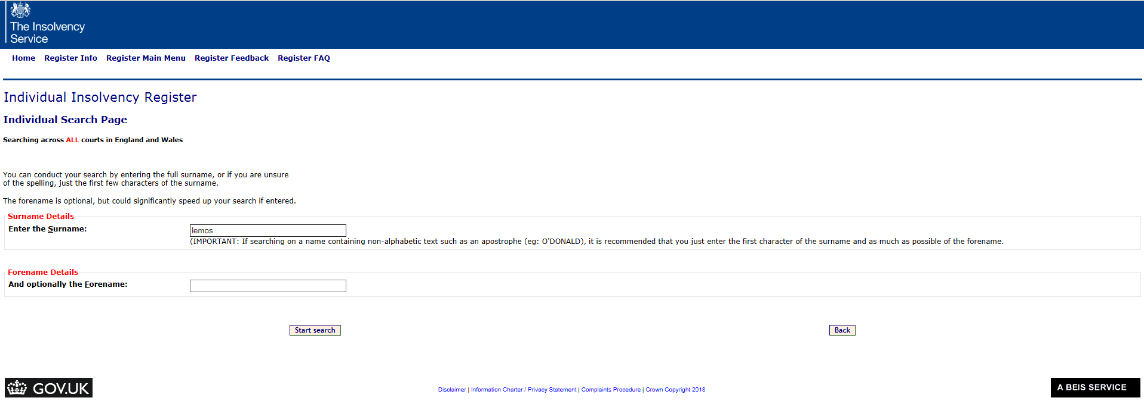

Slide 27
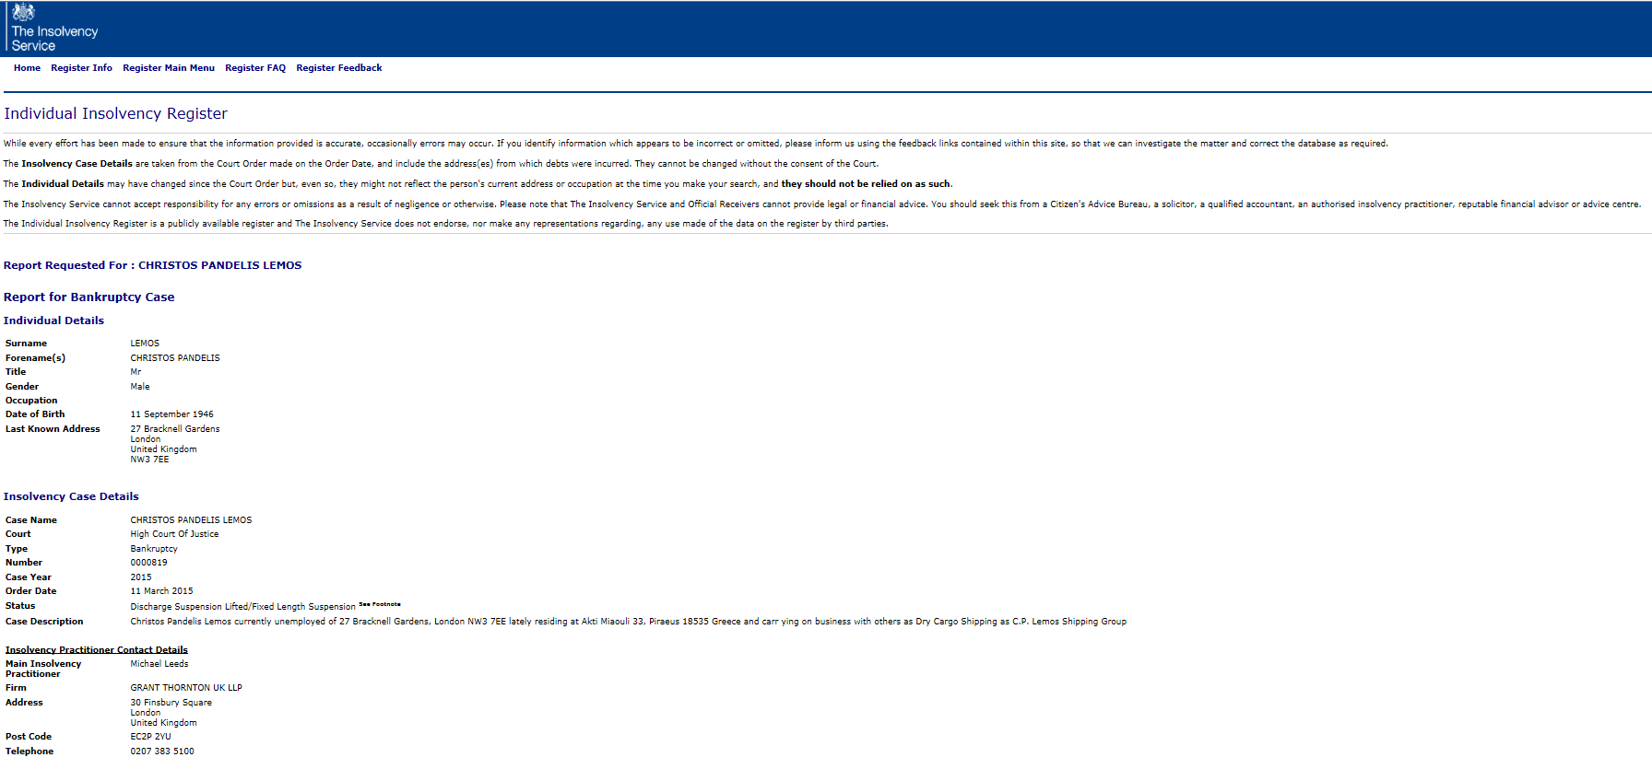

Slide 28
Obstacles and challenges
Funding of cases
Hidden assets / non-compliant bankrupt
Cross border investigations
Instructing foreign lawyers on a contingency basis
Serial bankruptcies
Privilege

