Slide 1

(A Union Government Company)
Information Utility Services
For Insolvency Professionals
Webinars
All rights reserved to NeSL | Confidential | Version 1.0

Slide 2
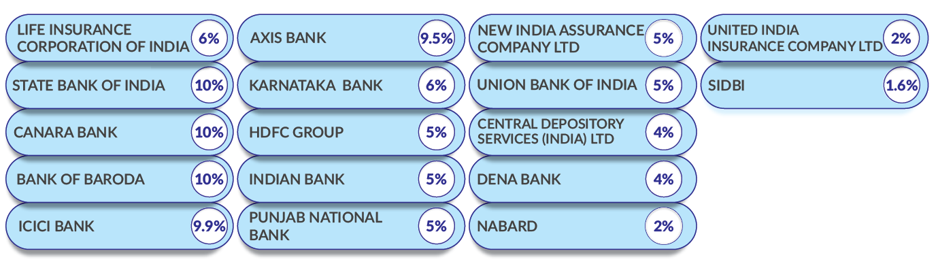
National E-Governance Services Limited.
NeSL was incorporated on June 2016 as a Union government company; Equity fully held by Financial institutions - public sector holds 65% of the equity. There are 17 shareholders – 13 banks, 3 insurance companies and 1 depository.

Slide 3

Regulatory Environment
Under:
Insolvency and Bankruptcy Code, 2016
Regulated by:
Insolvency and Bankruptcy Board of India
Compliances:
IBBI, Information Utility Regulations, 2017
Guided by:
IBBI, IU Technical Standards

Slide 4
NeSL IU – Journey so far
Mar’2017 : IU Regulations notified
Sep’2017 : NeSL given license by IBBI to commence operations
Nov’2017 : On-boarding of Operational creditors commences
Dec’2017 : RBI notifies banks/ NBFCs to submit to IU
Mar’2018 : On-boarding by banks
As of date March 31, 2020:
220 FIs - 73 Banks and 147 NBFCs have uploaded financial information
94.6% of loans to companies by value amounting to about Rs 63.92 lakh crore
16.49 Lakh records of loans to companies are uploaded on IU
7.76 Lakh records of loans to Individuals in Business are uploaded on IU
53.21 Lakh records of loans to Individuals are uploaded on IU
267 agreements signed with 69 banks and 141 NBFCs
Several private financiers and Operational Creditors have taken Record of Default

Slide 5

IU as repository of contract evidence
Financial or Operational Creditor as submitter
Bank filing loan or MSME files Supply details
Corporate / MSME
As Borrower or Buyer
Provides loan details or goods / services invoice
Uploads Form C for financial
or Operational Credit
Send authentication
request
Inform MSME about authentication Status
Authentication with or without disputes
Two way communication platform

Slide 6
Dispute Resolution Mechanism
IU platform in its current form facilitates recording of dispute and its resolution
Authentication by parties allow recording of dispute, with remarks
Resolution can be recorded by updating mutually agreed information or error-marking by the submitter, if the initial information was incorrect
All stakeholders, including NCLT, get visibility to the existence and past trail of any such dispute and its resolution.
NeSL plans to enhance the dispute resolution mechanism
Enable recording of multiple remarks and responses from both parties in dispute till resolution is achieved.
All remarks captured under digital signature
Communication trail to enable valuable insight to Adjudicating Authority

Slide 7
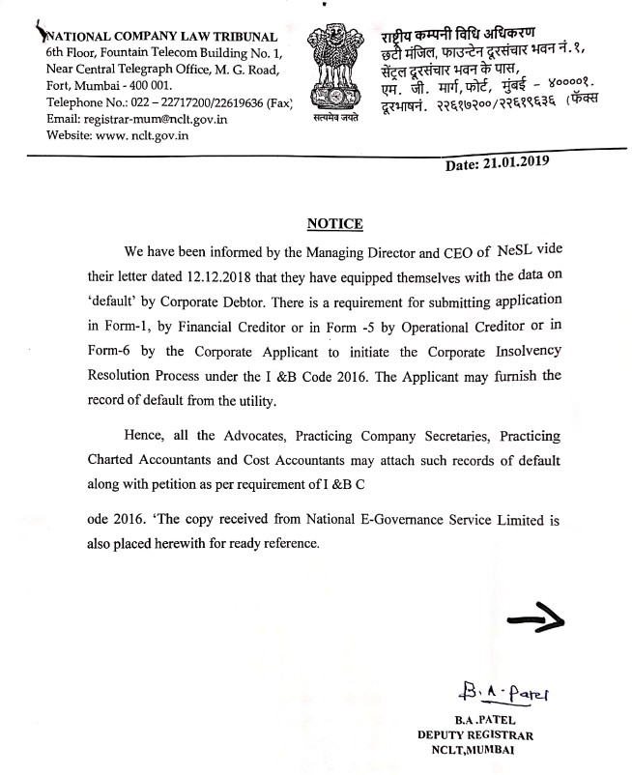
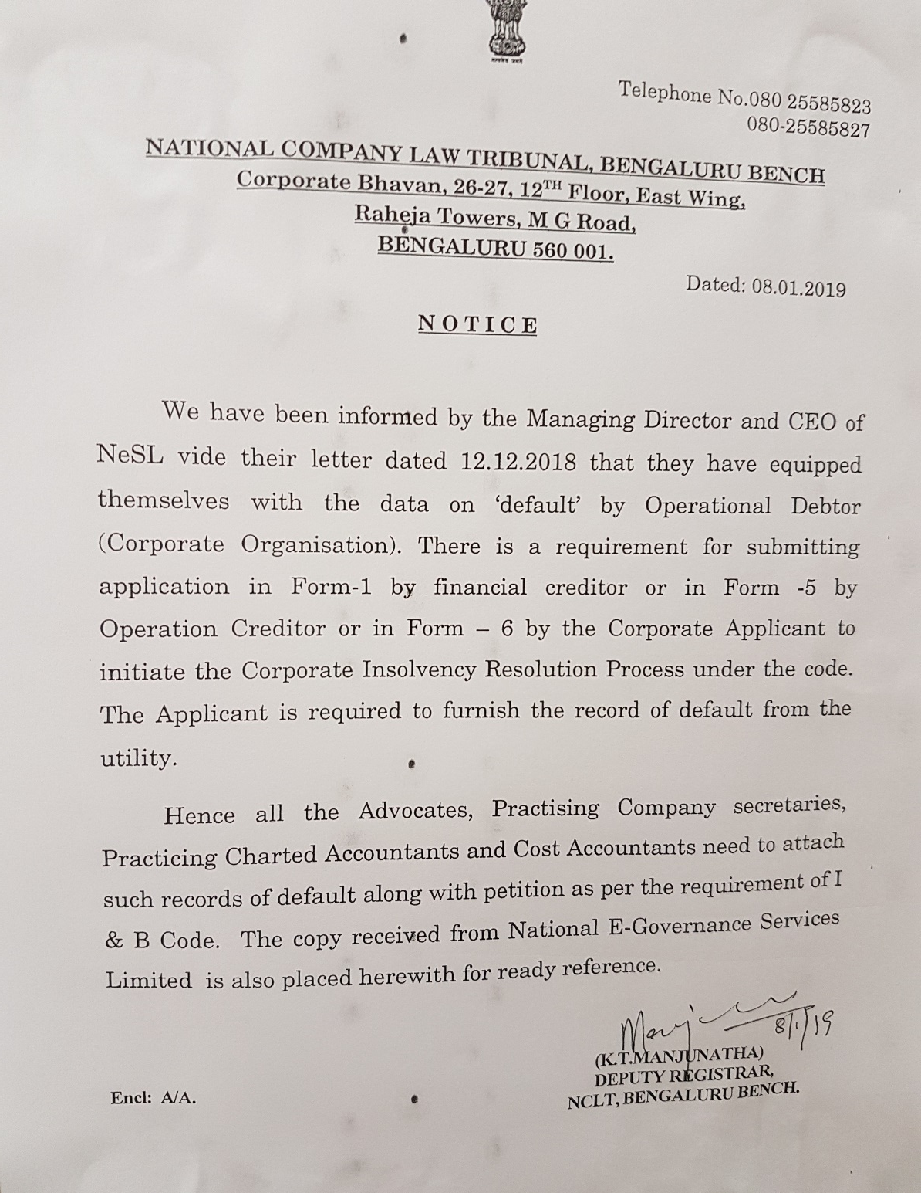

Slide 8
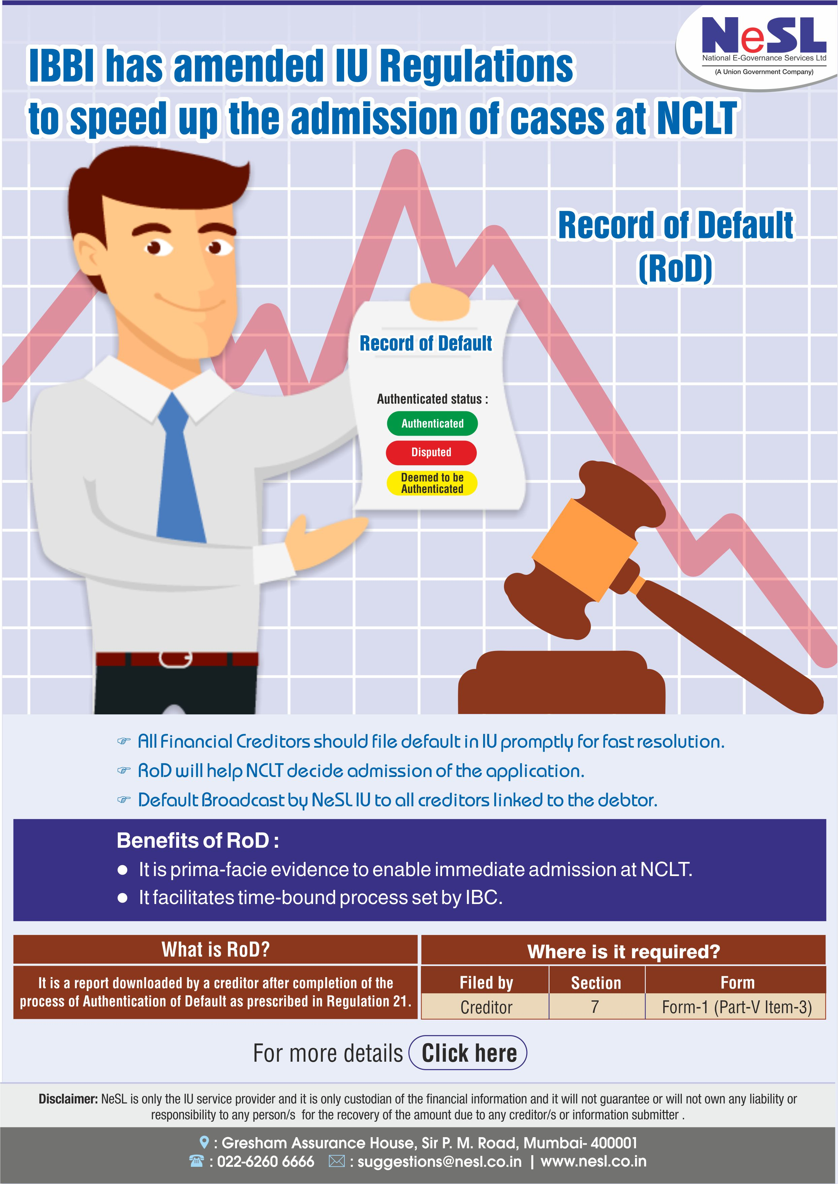
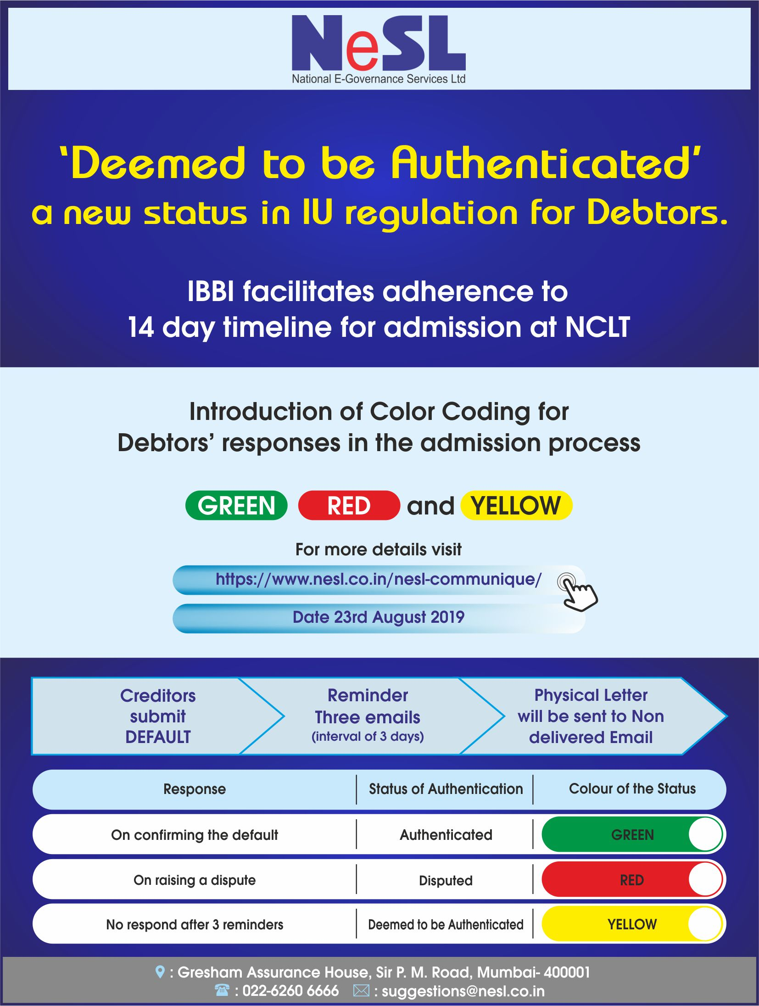

Slide 9

Default related Benefits to Users
Default alert broadcast : IBC is all inclusive - institutional and individual creditors – financial or operational; any party to debt can file contract details or default on IU that will serve as credit information or an alert, respectively. Design aims to provide an early warning system based on authentic data or prima facie legal evidence.
Record of Default from NeSL : a requirement under CIRP procedure and NCLT Delhi, Mumbai, Bangalore and Hyderabad have put notices that petitioner must obtain a record of default from IU
Credit Discipline: Submission of debt information on IU platform and subsequent authentication from the other parties brings transparency. Default alerts may impact reputation of defaulting entities – resulting in discipline in credit based transactions.
NeSL
Bank1
NBFC
Lenders
Bank 2
MSME

Slide 10
NeSL IU and Samadhaan
Operational Creditors

Slide 11
Integration of Samadhan and IU
Integration of SAMADHAN Portal and Information Utility can help achieve objective of Government to strengthen payment discipline where MSME offers credit based supplies to larger buyers, with minimum effort by MSME
Benefits from IU :
Digital signature by MSME on NeSL platform for legal support
Acceptance of invoice or Payment details entered by buyer, else
IU will disseminate default alert to all the creditors of the defaulter
MSME can revoke default or close the debt submission if unpaid amount is settled

Slide 12
Integration of Samadhan and IU
Samadhaan
NeSL IU
Start
1
Case Submission by Petitioner / Supplier
Unpaid invoice(s)
with consent for NeSL
Email and Call to Petitioner (supplier) - registration for registration
2
Registration of Pertitioner (supplier) Using
UAM / Aadhaar / DSC
3
4
End
Submission of Form C / Demand notice with Digital Signature or Aadhaar eSign by Petitioner (Supplier)
Authentication request to Respondent (buyer)
- 3 reminders
Status Update from NeSL
Submitted to IU
Default Alert Broadcast
Closure
6
5
Default Broadcast to other lenders of respondent (buyer) and Issue of
Record of Default
Action by Buyer
Default accept / disputed / payment details / No action (deemed accepted)

Slide 13
Information Access
For Resolution Professionals

Slide 14
Access of Information
Register
One time online registration as Insolvency Professional
Linkage with CD
Request for linkage with CD
Access Information
Access all information available in IU system
Upload AA/CoC order copy of assignment
Free of Cost
Online
Claim Verification

Slide 15
For Resolution Professionals
Insolvency Case Management System

Slide 16
Lifecycle of CIRP case
Formation of COC
Claim submission and verification
Asset Book
Verification of assets
Resolution Plan (RP)
Preparation of Information Memorandum
Valuer appointment
Meetings and decisions
List of Liabilities / COC
Compliances
Valuation reports
Access to information
Evaluation of RA
Liquidation
Invitation
Acceptance
Appointment of liquidator
Access to information
Auction logs
Distribution of funds
Sale as going concerns
Reports
Minutes of COC | Logs of eVoting | Cost Sheet | Non – Compliance | Grievances | Regulators reporting's

Slide 17


One Stop Solution
Information Access
Access of CD information
Helps in Claim verification
Case Management
End-to-End CIRP process
Claim Submission and verification
COC formation and Meetings
Reports and MIS (IPA/COC/IBBI/AA)
Preparation of IM
Compliance calendar and alerts
Virtual Data Room
Secure Storage of Information
Restricted access
Audit trail
Business Continuity Plan
Interim Finance
Invite proposal
Access of restricted information
Submission of proposal
Auction Platform
Public announcement
Access of info to interested parties
Fixing Terms and Conditions
Auctioning / bidding
INFORMATION UTILITY
IRP / IP / Liquidator

Slide 18
IBBI: PDA
Platform for Distressed Assets (PDAs)
Marketplace for Interim Finance
Virtual data room for Invitation of Resolution Plans/ Liquidation
Invitation and Evaluation of resolution plans
Auction during Liquidation

Slide 19
IP Module – Case Mgmt Solution
An End-to-End web based secured case management solution
assists IRP/RP to manage, comply with regulatory requirements and achieve the prescribed deadlines for Resolution Process/Liquidation
Stores information and restricts access as per need to stakeholders like Claimants, COC, Valuer, Liquidator & other stakeholders
Useful for Banks / NBFC to understand development on cases
Start to end workflow as per CIRP to ease the workload of IRPs/liquidator
Accessible to IPAs and IBBI for reports sent by RPs
Ready to go live
Did POC with the IRPs and accommodated their recommendation
Demonstrated to IPAs and IBBI

Slide 20
Solution
CoC Formation
Asset / Business Details
Invitation to Resolution Applicant
Evaluation of Resolution Plan
Information Memo for Liquidation
Information Memo for RA
Liquidation
Invitation and Evaluation of resolution plans
Virtual data room for Invitation of Resolution Plans/ Liquidation

Slide 21
ICMS : Functional - Features
User Management
Registration of User (creditor, IP, Valuer)
Create / update / delete – sub users
By Creditor
By Insolvency Professional
Case Registration
Compliance Calendar
Event Calendar
Forms generation
Alerts and Alarms
CoC
Claim Submission and Verification
CoC formation
Meetings
Agenda setting
Recording of minutes of meeting including proxy and voting details
Case Management
Appointment of IP (If different from IRP)
Business continuity
Recording of process cost
Recording of complaints
Recording of non-compliance
Resolution Plan / Liquidation
Appointment of Valuers & Valuation reports
Preparing Information Memorandum (WIP)
Invitation for Resolution Plan & Evaluation of Resolution Plan (WIP)
Appointment of Liquidators
Logging of Auction details, Costs details

Slide 22
VDR
Solution: Virtual Data Room (VDR) with functionality to:
Enable IRP/RP/Liquidator to securely collect/prepare/maintain/update business/asset information
Enable IP in their role as IRP/RP/Liquidator to make public announcement inviting prospective RAs to request access to business/asset information of CD in CIRP or Liquidation
Enable IRP/RP/Liquidator to grant access privileges to RAs for a limited period of time so that they can only read business/asset information of one or more CDs
Enable collection of information for reporting purposes:
Who was granted access and/or exercised the access privileges ?
What business/asset information was accessed ?
Which Corporate Debtors’ business/asset information was accessed ?

Slide 23
Use in External Confirmation
Auditing on Governance

Slide 24
Use of IU by auditors
Auditors can be user of IU
CA/CSs can be registered as authorised user of the debtor and access the information available against the him/her.
ICAI issued notification : Using Information Available at Information Utility (IU) Platform for External Confirmations
Benefits from IU :
Access of authenticate information
Saving of time consuming process of external confirmation of dues through offline mode

Slide 25
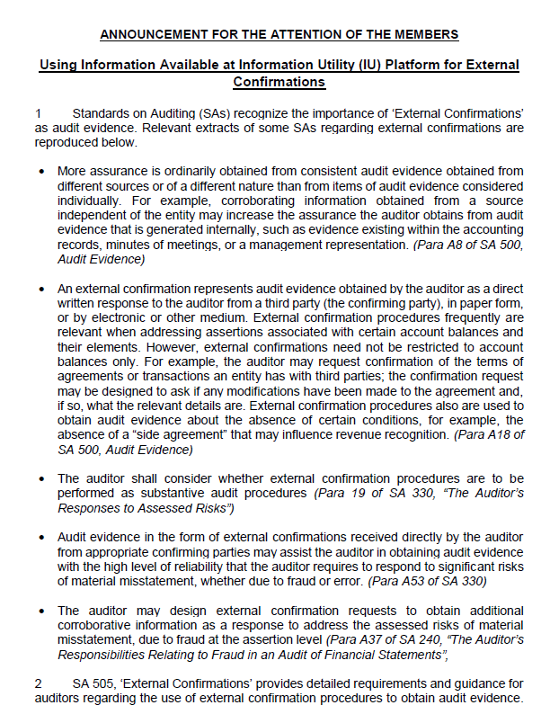
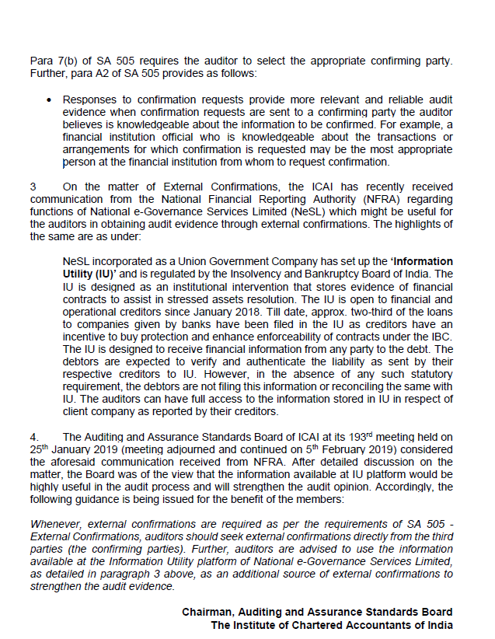

Slide 26
Other IU Initiatives
Consortium Loan platform
For effective collaboration by borrower and consortium members
Facilitated by IBA
NCLT E-Court System Integration
On-line petition filing with RoD from IU
Alert to creditors
Demand Notice Generation for Operational Creditors
State Govt Tax Dues recording
Maharashtra and Tamil Nadu in advance stages of discussion
Secondary Loan Market facilitation (RBI initiative)
Task Force report recommends IU being used as the Central Loan Contract Registry (CLCR) to enable effective secondary market for loans

Slide 27
(A Union Government Company)
Thank You!!
Registered Office
Gresham Assurance House, 4th Floor, Sir P M Road, Fort, Mumbai 400 001. Phone: 022-6260 6666
Administrative Office:
#003A, Ground Floor, “The Estate” Building, 121, Dickenson Road, Bengaluru – 560 042 Phone: 080-2558 0360
“The Knowledge Forum”
February 01, 2019
Mumbai
www.nesl.co.in

