Slide 1
Legal Interpretation
Madhusudan Sharma

Slide 2
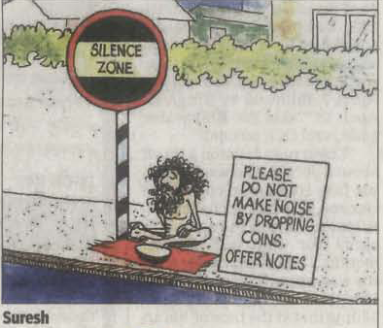
Interpretation?

Slide 3
Interpretation?

Slide 4
Whenever any new dispension comes into force it brings along a large number of challenges. The parties to litigation make effort to project a view point suitable to each one of them confronting the courts with the gigantic task of implementing the provision of a new statute rolling out of the new regime in a manner as to achieve its primary object.
Justice MM Kumar, J R Varadharajan, and Ms Deepa Krishan, NCLT (IBC) – 190 (PB) / 2017 16.02.2018

Slide 5
Interpretation of Statutes
Word of everyday use must be constructed in its popular sense
When material words are capable of two meanings, one of which is likely to defeat or impair the purpose and policy of the Act and another likely to assist achievement then courts would prefer the later.
Principle of Literal construction. Where the words of a statute are plain, precise and unambiguous, the intention of the Legislature is to be gathered from the language of the statute itself and no external aid is admissible to construe those words.

Slide 6
Mischief rule
Get an exact conception of the aim, scope and object of the whole Act to consider:
What was law before the Act was passed?
What was the mischief and defect for which the law had not provided?
What remedy Parliament has resolved and appointed to cure the disease? and
The true reason of the remedy
And then the judges have to make such construction as shall suppress the mischief, and advance the remedy, and to suppress such inventions and evasions for continuance of the mischief.

Slide 7
Sometimes clear and simple language may also pose great difficulty
In PV Narashimha Rao v. State (CBI), regarding bribes paid for defeating no confidence motion.
Held by majority, a member who voted in parliament after receipt of bribe cannot be prosecuted due to immunity under Article 105(2). However illegal gratification for abstaining from voting was not entitled to immunity.
Article 105 (2) of the Constitution “No member of Parliament shall be liable to any proceedings in any court in respect of anything said or any vote given by him in Parliament or any committee thereof,.....”

Slide 8
Aids to Interpretation
Internal and External aids:
Internal Aids those found within the statute: Title or Preamble of the statute, Definitions, Chapter Headings, Marginal Notes, Punctuations, Provisos, Explanation, Saving Clauses and non-obstante Clauses.
External Aids not contained in the statute: Historical background, Statement of objects and reasons, original Bill as drafted and introduced, Debates in the Legislature, State of things at the time a particular legislation was enacted, Judicial construction, Legal dictionaries and Commonsense.

Slide 9
जय हिन्द Jai Hind
धन्यवाद Thanks
Madhusudan Sharma
Advocate, Insolvency Professional, FCS, FCMA
madhusudan.ip@outlook.com 9868872918
Website: www.madhusudansharma.in

