Slide 1
Practical Challenges and Remedies – Pre and Post Insolvency Resolution Process
January 8, 2019

Slide 2
Pre-corporate insolvency resolution process
Delays in admission
Applications under sections 7, 8 and 9 to be admitted within 14 days from the date of filing of application;
Severe delays in admitting the applications by NCLTs, adherence to timeline crucial.
Remedies
Need for more NCLTs;
Undue leeway to CDs (extra timeline to file reply, extension on ground of settlement talks) should not be provided.

Slide 3
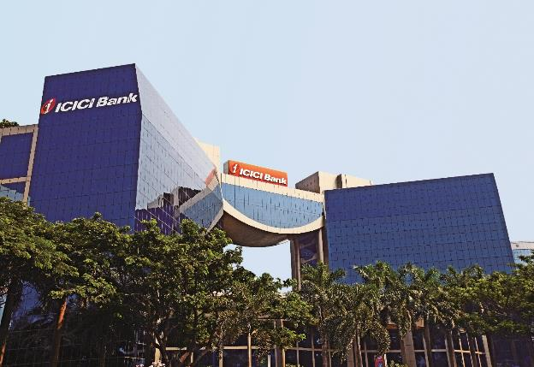
During-corporate insolvency resolution process
Lack of reliable and detailed information
Collation of data/information about corporate debtor-a challenge for IRP/RP;
Information available on different platforms; lack of proper books/accounts;
Lack of market interest in IUs- only one incorporated till date.
Remedies
More power to IRPs/RPs to demand information;
IUs to be made more dynamic to generate market interest.

Slide 4
Contd..
Adherence of timelines
As per the IBBI data, 1298 cases have been admitted under the IBC till December 1, 2018 and only 4% have been resolved. Nearly, 30% of the pending cases have crossed 270 days’ deadline;
EoIs received beyond stipulated timelines, late bidding, lack of information about CD- a ground for late submission of bids/EoIs.
Remedies
Code to be modified to allow CoC to reject resolution plans submitted after stipulated timelines, information in the market regarding CD, websites to be updated regularly by RPs.

Slide 5

Contd..
Third Party Security
Definition of “Financial debt”- does not cover third party securities;
Contradictory views by NCLTs- SBI v. CE Limited, ICICI Bank v. Jaypee Infratech
Remedies
  Definition of Financial debt should include third party securities as well.

Slide 6
Contd..
Preferential Transactions
Section 43, avoidance transactions; objective test by RPs, multiple applications filed by RPs;
UK and Hong Kong- “desire test” followed- CD must have desire to do such transactions.
Remedies
Code/regulations should be modified, RP must arrive at the conclusion that the CD had desire to do such transaction.

Slide 7
Contd..
Diversified businesses
Companies with diversified businesses, reluctance to accept separate resolution plans for separate businesses; diversified business segment attracts lower investment; multiple resolution plans not accepted for separate business segments.
Remedies
Separate resolution plans for each segment of business of a CD should be allowed- value maximization; and
Code or the regulations may be modified.

Slide 8
Contd..
Differential treatment amongst FCs in a resolution plan
No provision in the Code or the regulations dealing with differential treatment of FCs on the basis of security interest (ranking of charge, value of security interest), no difference between secured and unsecured creditors;
NCLAT in Binani Industries- differential treatment of similarly placed creditors not allowed under the Code.
Remedies
Code must give credence to ranking/value of security interest.

Slide 9
Contd..
Operational difficulties in counting votes
Abstain from voting is taken as negative voting, voting thresholds are not met due to this interpretation, may lead to liquidation of CD or stalling decisions of CoC.
Remedies
Calculation of voting share should be done on the basis of present and voting; similar position under UK law, recommended by insolvency committee report.

Slide 10
Post-corporate insolvency resolution process
Failure of RAs to adhere to commitments under resolution plans
RAs have failed to adhere to their commitments under resolution plans, and LoIs, after approval by CoC and NCLT; no stringent provisions in the Code for defaulting RAs; waste of time, resources and effort, misuse of the Code;
Liberty house failed under resolution plans in Amtek Auto and Adhunik Metaliks Ltd.
Remedies
Stringent provisions in case of default by RAs should be provided, section 74(3) should be amended.

Slide 11
Contd..
Lack of clarity on monitoring of resolution plan
No specific provision under the Code or regulations for monitoring of resolution plans, resolution plans usually provide for monitoring agency (RA, RP, CoC representatives)- a contractual relationship, lack of adequate mechanism to take decisions.
Remedies
Organised/formal monitoring agency ecosystem should be developed.

Slide 12
Contd.
Option to change the Liquidator
Section 34, RP to be appointed as the liquidator;
no option to change the liquidator by creditors- if dissatisfied with the RP.
Remedies
CoC/creditors should have the option to change/replace the liquidator.

Slide 13
Contd..
Monitoring of litigation/cases initiated by the RP
RP initiates many litigation/proceedings under the Code like preferential, fraudulent, extortionate transactions etc., proceedings are usually not decided during the resolution process, lack of clarity on monitoring of these proceedings after the resolution plan is approved.
Remedies
RP should be authorized to monitor and ensure completion of such proceedings.

Slide 14
Thank you

