Slide 1
Information Utility
Insolvency Professional Module
20 December 2018
Confidential | Version 1.0

Slide 2
National E-Governance Services Limited.
NeSL was incorporated on June 2016 as a Union government company; Equity fully held by Financial institutions - public sector holds 65% of the equity. There are 17 shareholders – 13 banks, 3 insurance companies and 1 depository.

Slide 3
NeSL IU – The Journey So Far
Mar’2017 : IU Regulations notified
Sep’2017 : NeSL given license by IBBI to commence operations
Nov’2017 : On-boarding by Operational creditors commences
Dec’2017 : RBI notifies banks/ NBFCs to submit to IU
Mar’2018 : On-boarding by banks
As of date:
114 FIs (44 Banks, 70 NBFCs) on-boarded
87% of loans to companies - value Rs 37.90 lakh crore
5.97 Lakh records of loan to companies (BSR)
13.58 Lakh records of loans to partnership, Businesses and Individuals
173 agreements signed with 61 banks and 112 NBFCs
Several private financiers and Operational Creditors have taken Record of Default

Slide 4
Information Utility
Schematic Workflow
Creditor Submits the debt information
NeSL accepts and send authentication request to Debtor
Creditor
Information Utility
Debtor
Confirmation on information authentication status
Debtor authenticates /disputes the information
View debt information across creditors / Uploading documents related to insolvency process
Reports
IRP / IP
IBBI / NCLT / DRT

Slide 5
Existing Core Services
Registration
Online registration with electronic identification process
Robust operations team
Call centre support – Inbound and outbound
Data Submission
Bulk Upload through SFTP / web browser
Screen Based data entry
Hand holding sessions and technology support to Banks
Authentication
Digital Signature
Aadhaar E-Sign
Reports
Authentication Status Report
Record of Default
Financial Creditor
Operational Creditor

Slide 6
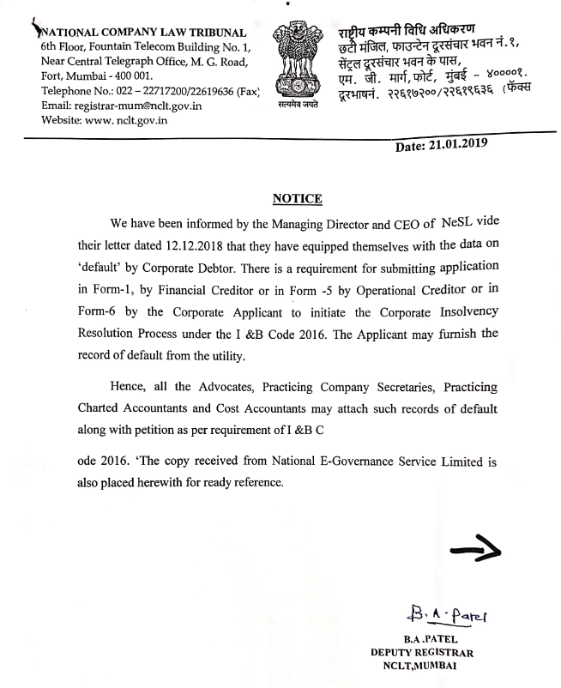

Slide 7
IU Regulations
Section 38 of IBBI Information Utility Regulations, 2017
Storing information submitted by insolvency professionals.
An insolvency professional may submit reports, registers and minutes in respect of any insolvency resolution, liquidation or bankruptcy proceedings to an information utility for storage.
The information utility shall not provide access to the reports, registers and minutes submitted under sub-regulation (1) to any person other than the concerned insolvency professional, the Board or the Adjudicating Authority.
The information utility shall discharge the duties specified in Chapter VI in respect of the reports, registers and minutes submitted under sub-regulation (1).

Slide 8
Benefits from IU system
Access of Authenticate information of loans and advances of defaulter.
Creditors information – can be connected offline and asked to submit the claim
Helpful in claim verification process
An insolvency professional may submit reports, registers and minutes in respect of any insolvency resolution, liquidation or bankruptcy proceedings to an information utility for storage
Can be used as Business continuity
Change from IRP to IP
IP to liquidator etc

Slide 9
Expectation from IPs
Registration
As on Dec 2018
IPs registered with IBBI : 2290
IPs registered with NeSL : 173
As on Mar 2019
IPs registered with NeSL : 204
Linking with defaulter and accessing the information
Storage on IU system

Slide 10
IP Module
Registration
Linking with Debtor
Accessing / Retrieval of Information
Uploading Documents
Accessing Debtor’s Information
IP is required to get registered on the NeSL online portal.
Post registration, IP will submit a request on NeSL portal to link with particular debtor/defaulter entity against whom insolvency resolution initiated, along with Court/NCLT appointment letter.
NeSL operations team will process the request on the basis of supporting documents
Post linking, IP can view/access details of the debt information available against that entity
During the proceedings/process, IP can upload the details/ documents in the NeSL IU portal for the future reference.
In case of change in the IP, New IP can access details and documents uploaded by the previous IP
NeSL IU will charge for IP for storage

Slide 11
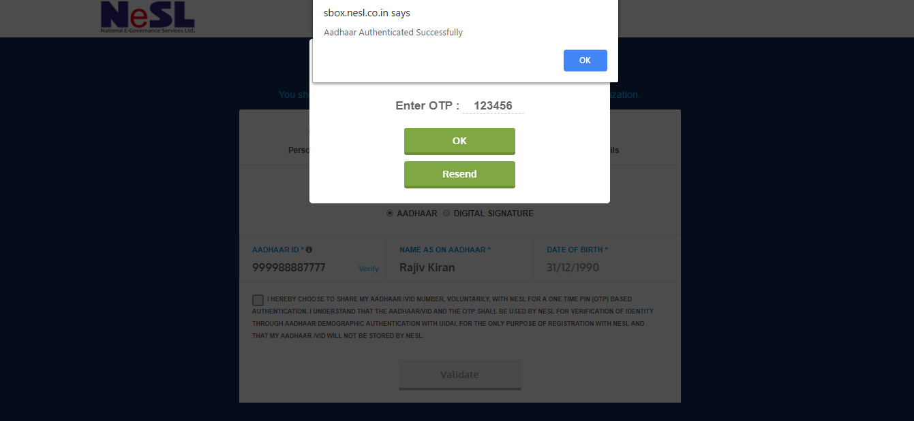
Enter OTP received on linked mobile number

Slide 12
Click On “Checkbox”

Slide 13
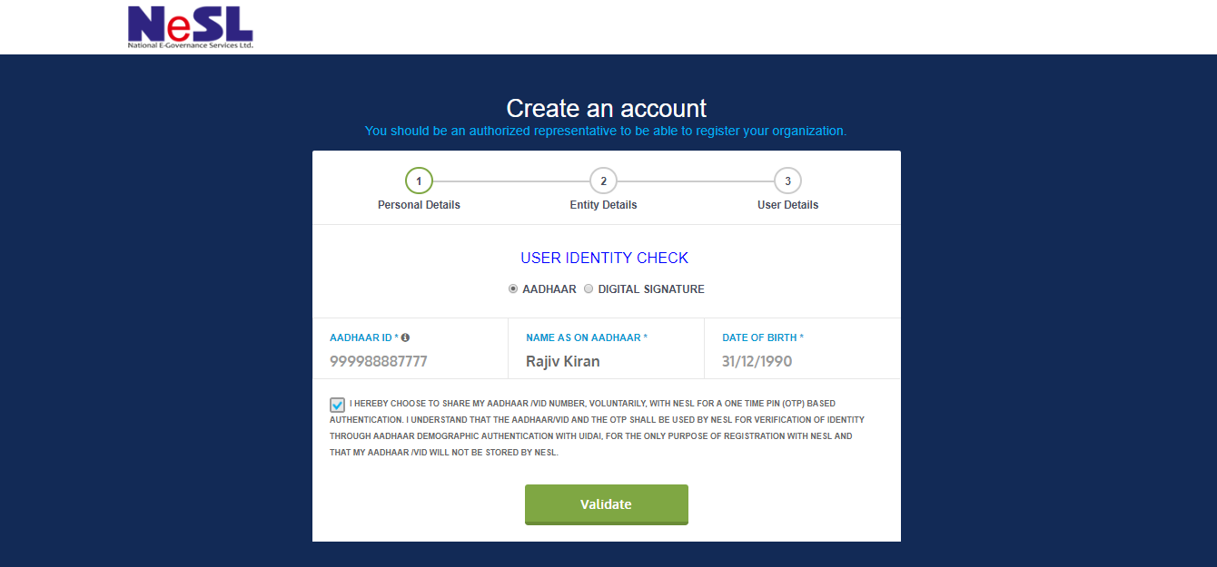
Click on Validate

Slide 14
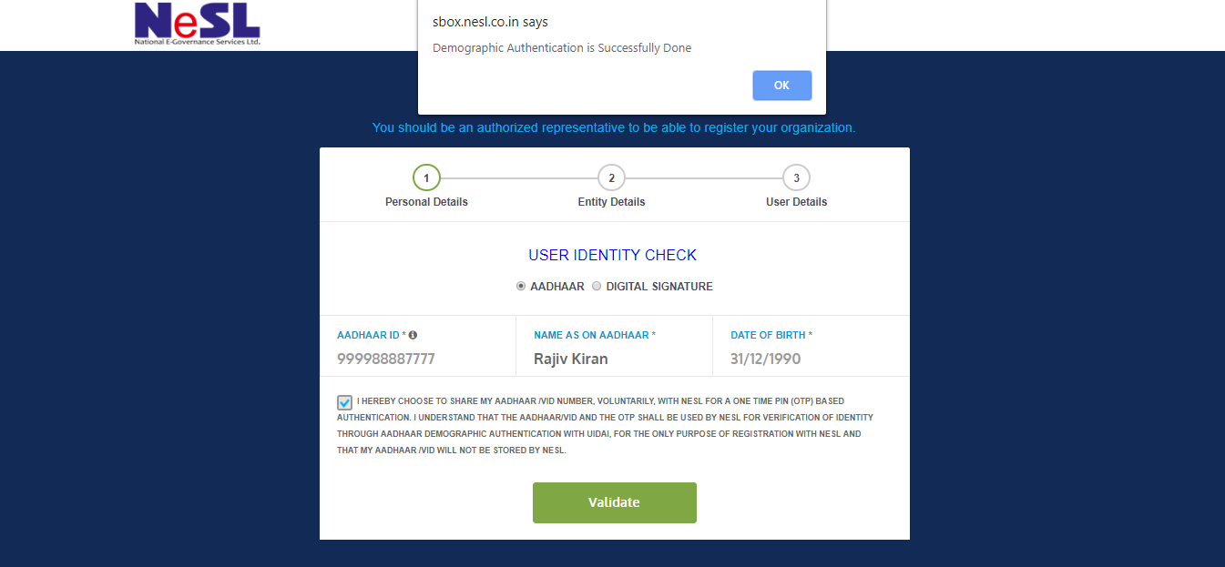
Successfully Submission

Slide 15
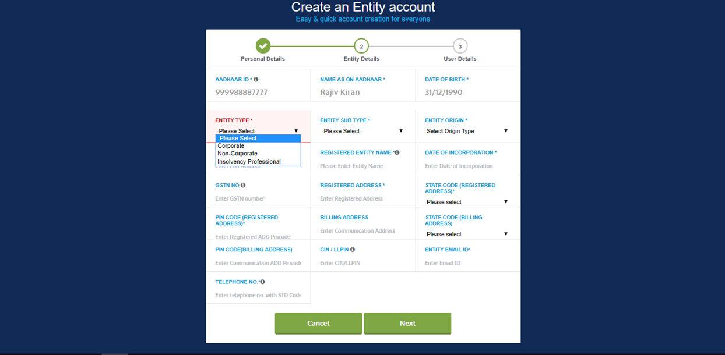
Select Entity as
“Insolvency Professional”

Slide 16
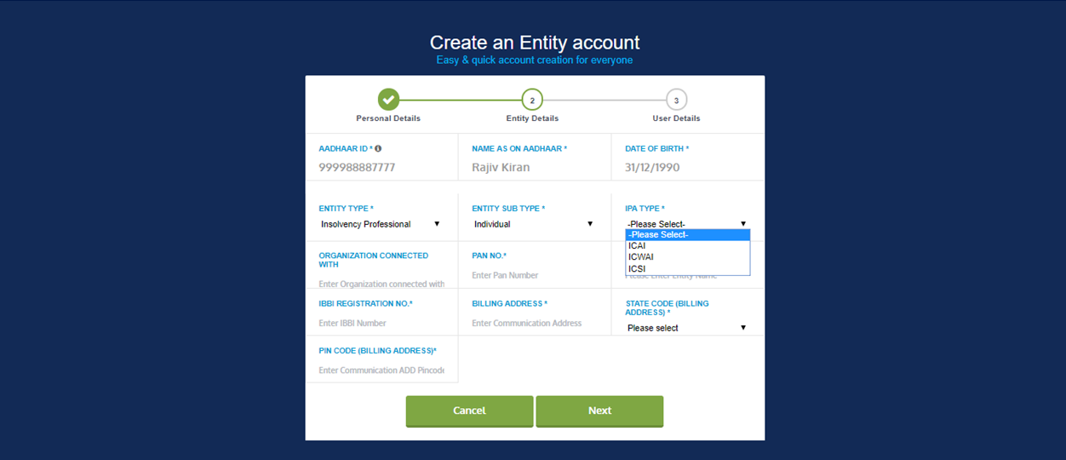
Select IPA Type from Dropdown
ICAI
ICWAI
ICSI

Slide 17
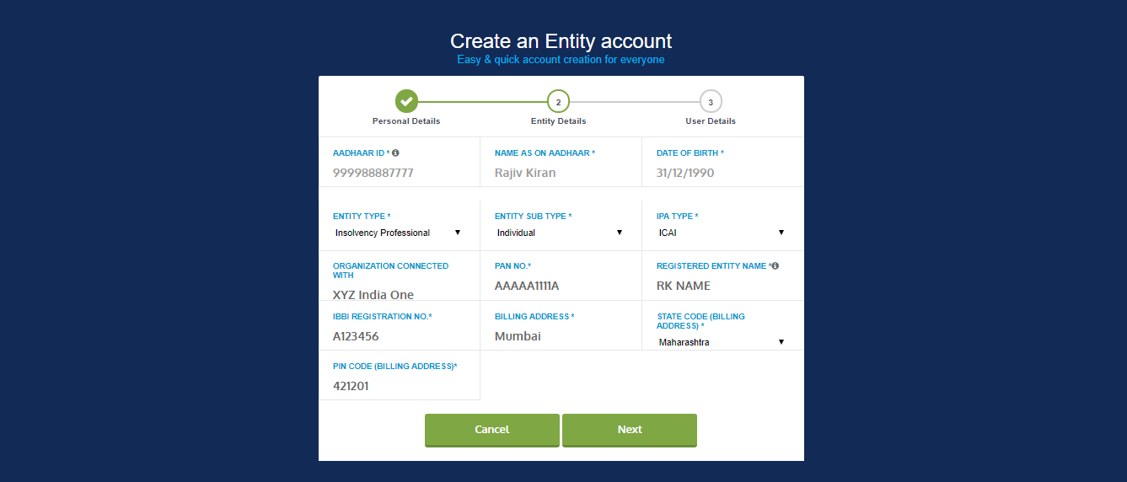
Enter All other details Properly and Click on Next

Slide 18
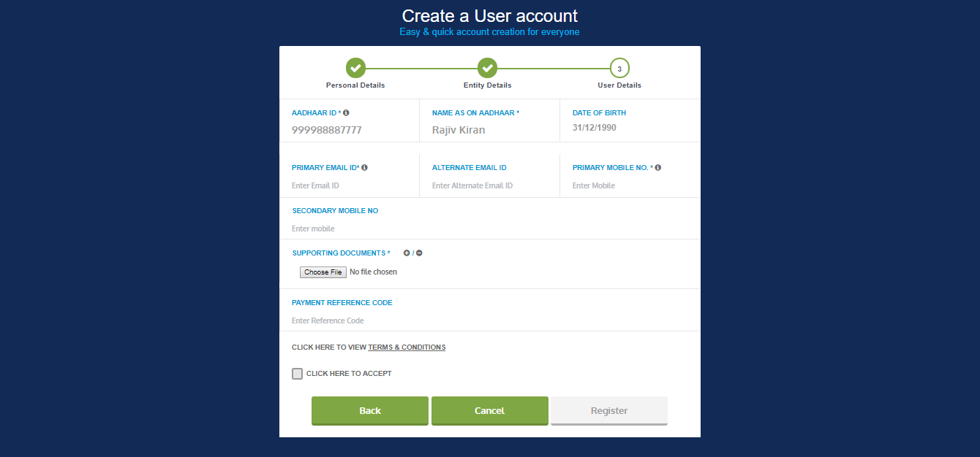
Enter Contact details for all Communication.
Enter Supporting document for verification in “PDF” format.
Click on Checkbox
Register

Slide 19
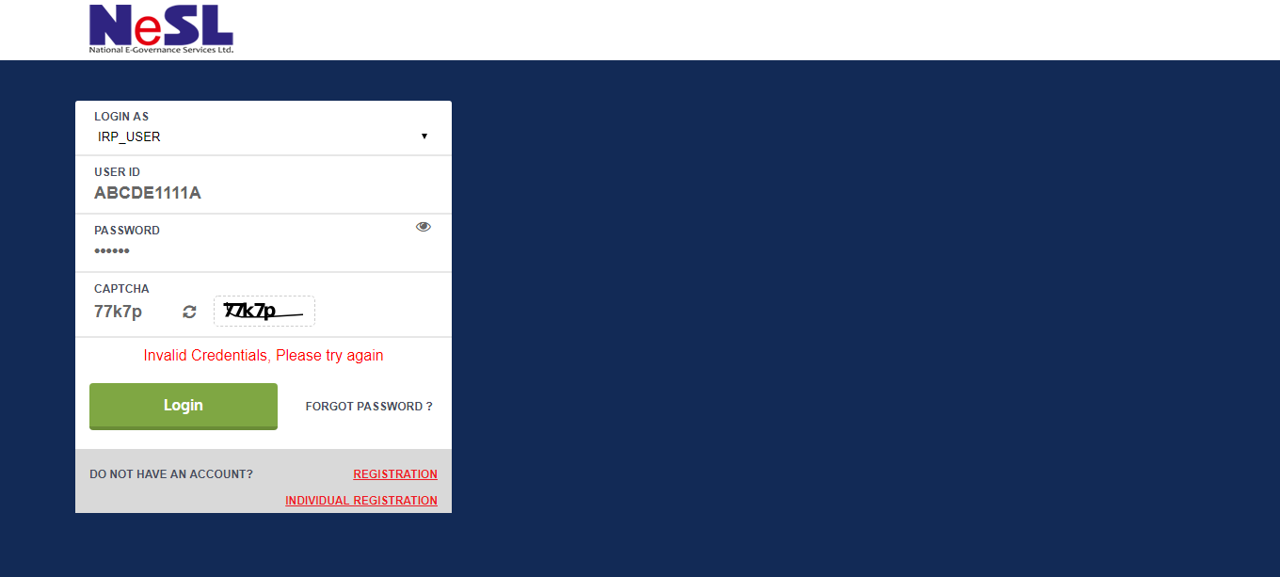
One Registration is done, within 24 working hrs NeSL Team will verify the data and documents. You will receive Login credential via Email or text.

Slide 20
NeSL – IU Portal

Slide 21
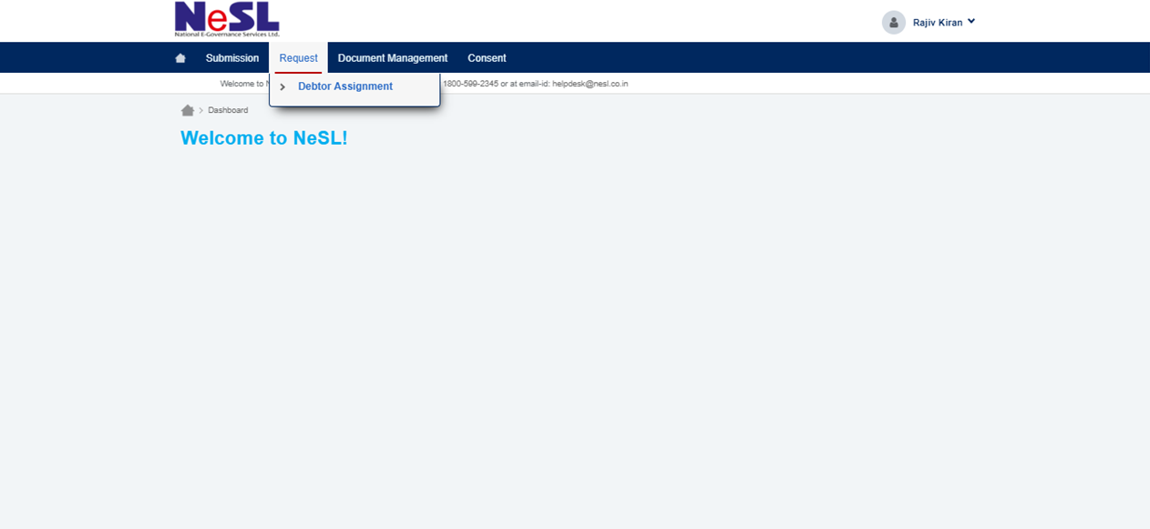
To request Debtor Assignment or Debtor Loan details we need Click on
Request >> Debtor Assignment

Slide 22
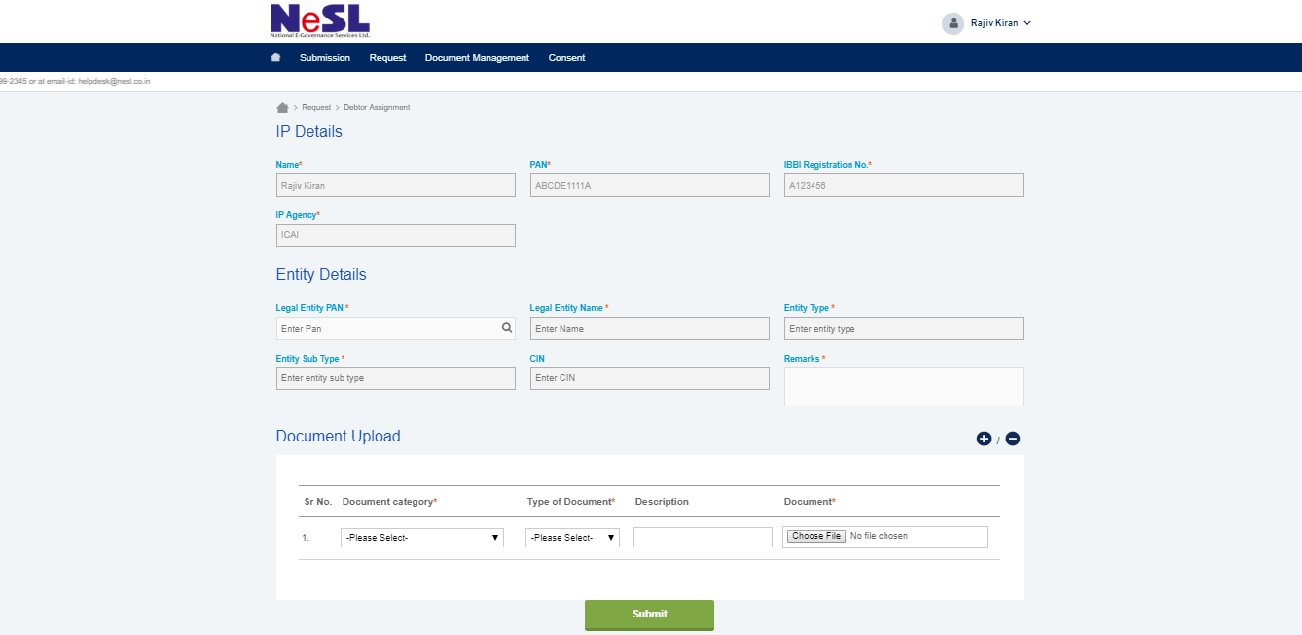
IP Details
Enter PAN number of Entity to which you need to request the Debt Details

Slide 23
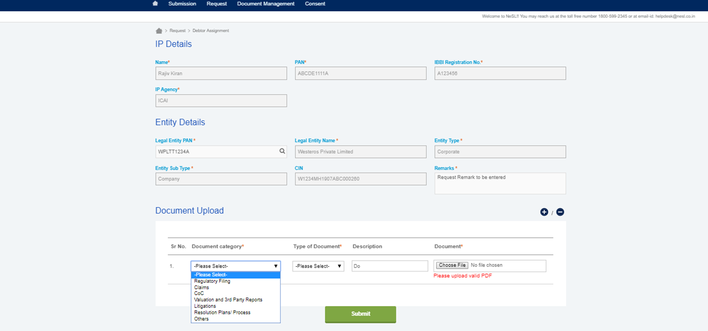
Once PAN details is entered, Click on Search Tools Beside it.
Add Remark
If the Entity is register with us, the details will be displayed.
Upload the supporting Documents with description and Submit.

Slide 24
Category of Documents
Regulator Filing
NCLT Order Public Announcement Appointment of valuers E – Voting Results Information Memorandum Other
Claims
Claims Notices Others
Resolution Plans/Process
Resolution Plan Liquidation Documents Distribution of Released Cash Details of Bidders Other
Litigation
NCLT Proceedings
Valuations & 3rd Party Reports
Asset Related Valuation Report Other
Other
Audited Financial Statements Record of Business operation Promoter Details Other
CoC
Minutes of Meeting Other

Slide 25
Once submitted, you will receive reference no. on your email ID and NeSL Team will verify the Details and Document and will approve and reject.
Submit

Slide 26
Information Utility
How to View Debtor Details

Slide 27
You will able to see debtors details Or
C Form once it is approved by NeSL Team
Click on Submission >> View Existing Loan

Slide 28
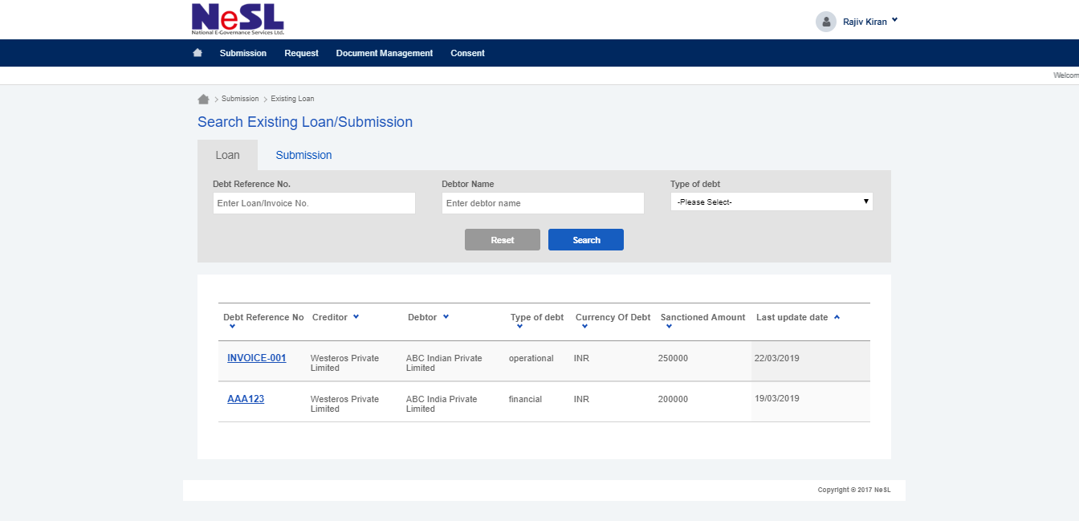
Loan Tab : Number of loan Available/Uploaded by Financial or Operational Creditor.
Also can search by Debt Reference no. or Debt type.
Click to Open

Slide 29
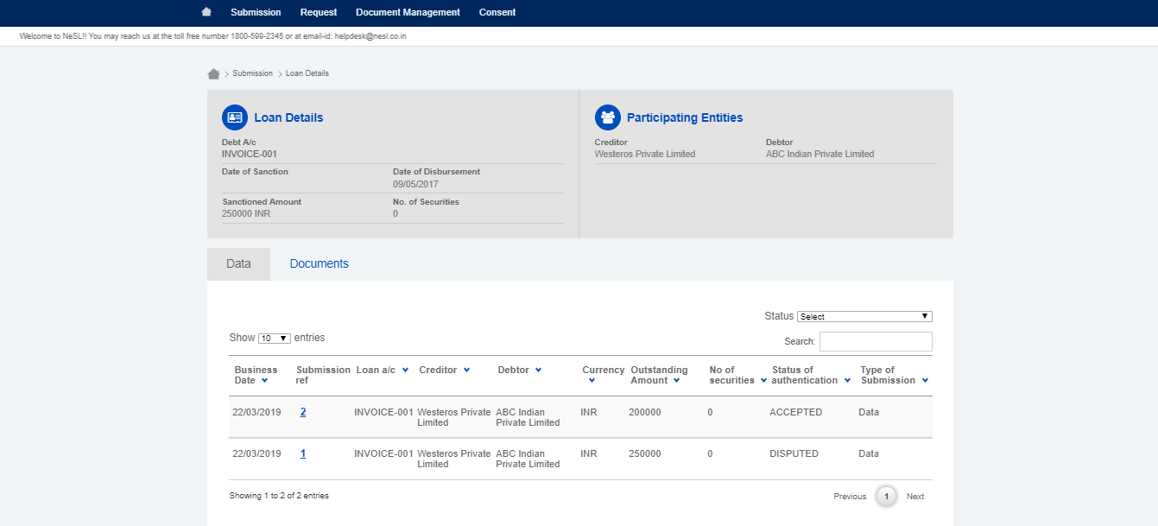
Loan Details
C Form
You can check the number of submission
Accepted
Disputed

Slide 30
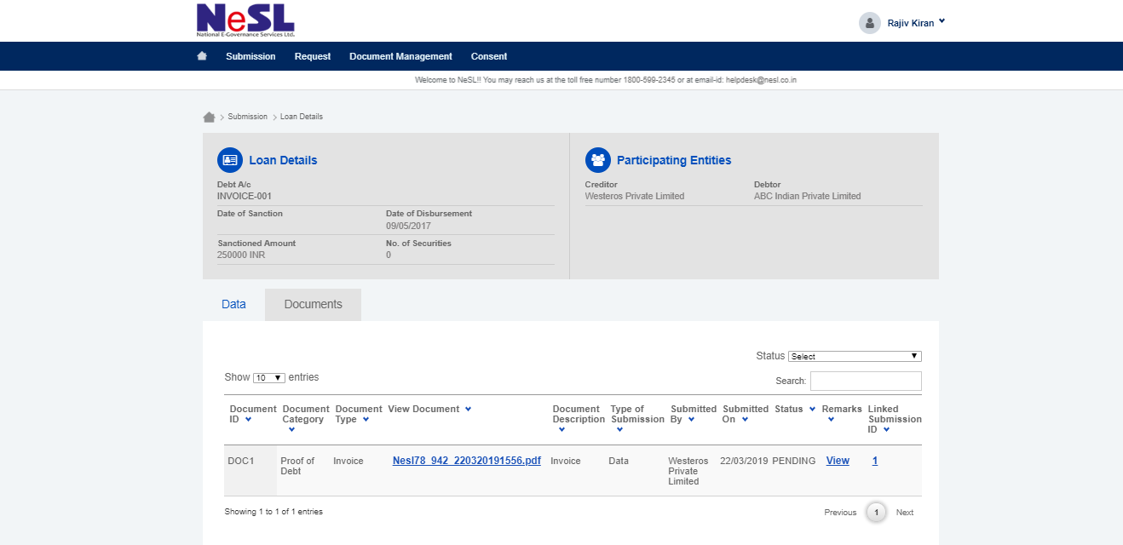
Document upload

Slide 31
Information Utility
How to View Debtor Documents

Slide 32
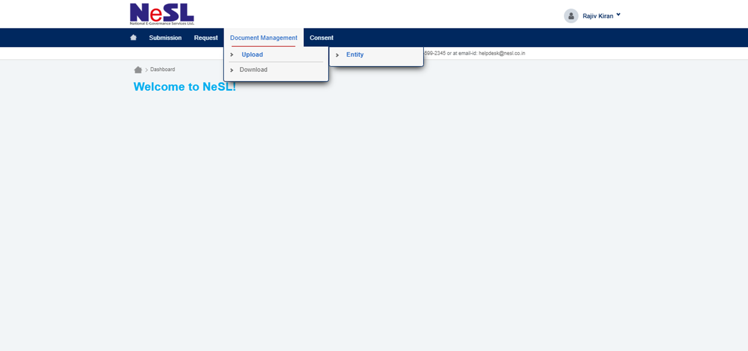
To Upload and Download the Documents
Click on Document Management
>>
Upload >> Entity

Slide 33
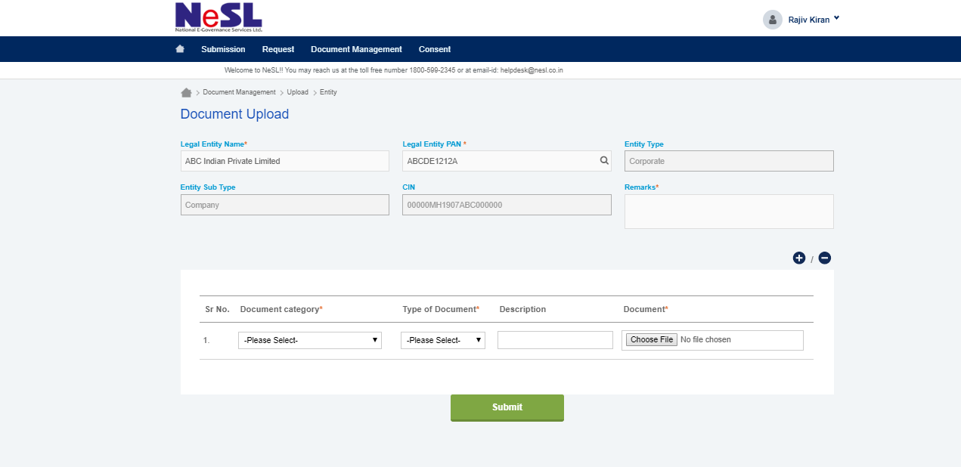
Search with Legal Entity Name OR PAN Number.
Add Remarks
Select in Dropdown for the list of Document and type, add Description and Submit
Add Document with Digital Signature

Slide 34
Successfully Uploaded

Slide 35
Download the Uploaded File/Documents
Click on Document Management
>>
Download >> Entity

Slide 36
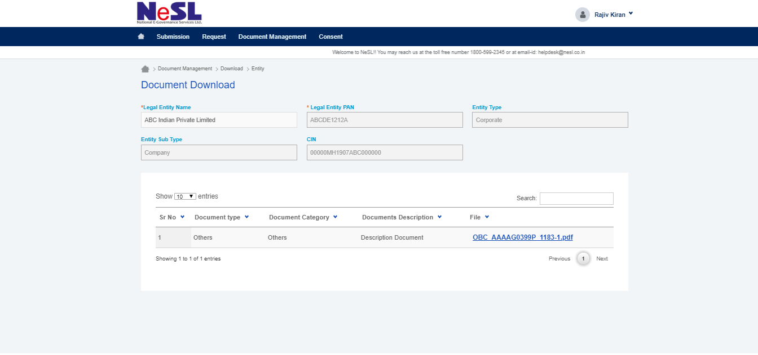
Search with Entity Name
List of Document Uploaded against that Entity

Slide 37
Costing For Insolvency Professional Services

Slide 38
Thank You!!

