Slide 1
CMAI RVO Tuesday, April 30, 2019, Delhi
on
CONTINUING EDUCATION
PROGRAMME
Gagan Ghai
FCA, ACMA, CVA, FIV
9899 522 635
Gagan@crestcapitaladvisors.com

Slide 2
Key Pointers
Valuation Scenario
History
Importance
Statues

Slide 3
Valuation
Accurate valuation data is essential to business and to the stability of our financial markets.
Businesses rely on valuation data to:
Establish the underlying value of their assets
Make informed and de-risked investment decisions
Comply with financial reporting rules and regulations
Compare and benchmark asset performance
Manage risk effectively
Inaccurate and poor quality valuations add risk and hinder business. Poor valuations erode business and public trust and undermine stability in the financial system

Slide 4
History
1957
Wealth Tax Rules
1990
CCI Fixed Pricing –NAV, PECV, MV(Listed)
1992
SEBI- IPO Pricing via MB
1994-99
ICAI Technical Guide on Valuation
2010-2014
RBI FDI Valuations via DFCF Method
2009-2010
Income Tax Issued Valuation for transfer of shares and ESOPs
2013
Registered Valuation Rules
2016
IND AS initially for listed companies then for others year wise

Slide 5
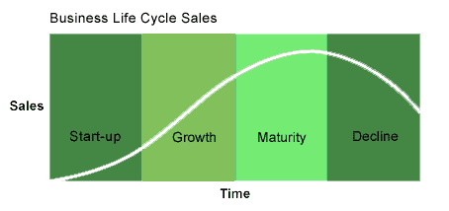
Valuation across cycle
Valuation is required in every phase of business cycle

Slide 6
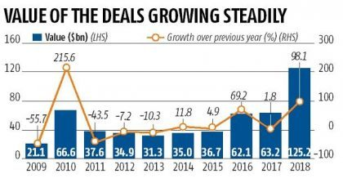
India M&A

Slide 7
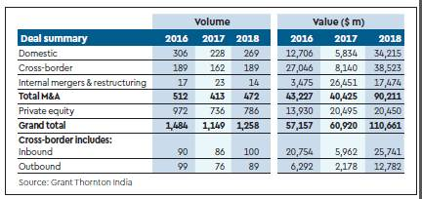
India M&A

Slide 8
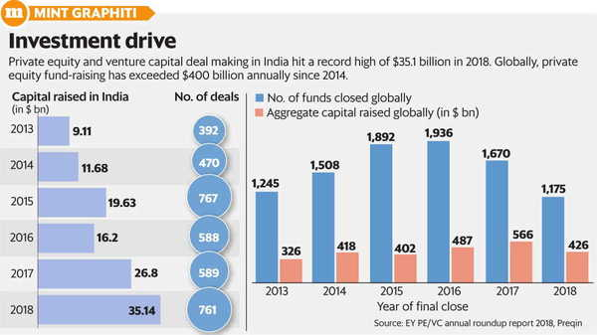
India PE, VC deals

Slide 9
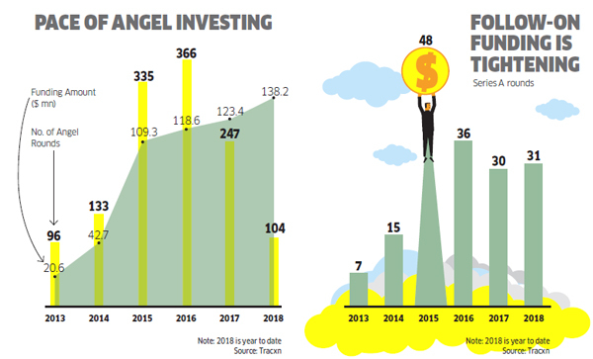
Indian Angel deals

Slide 10
Why Valuation
Transactional
Mergers
Acquisitions
Regulatory
RBI
Accounting
ESOPs
Impairments
Fund Raising
Business Sale
Voluntary assessments
Income Tax
SEBI
Companies Act
Stock Exchange
IBC
Courts
Purchase Price allocations
IND AS Fair Value

Slide 11
Companies Act 2013
The Companies Act 2013 prescribes Valuation by a registered valuer under the following Sections:
• Section 62 (c) – Issue of shares on rights basis
• Section 192 (2) – Non cash transactions with Directors
• Section 230 – Compromise or arrangement with creditors and members
• Section 236 – Purchase of minority shareholding
• Section 247- Registered Valuer
• Section 260- Valuation in respect of Shares and Assets to arrive at the Reserve Price for Company Administrator
• Section 281- Valuing assets for submission of the report by Company Liquidator
• Section 305- Report on Assets for declaration of solvency in case of the proposal to wind up voluntarily
• Section 319- Valuing interest of any dissenting member under Power of Company Liquidator to accept shares etc., as consideration for sale of the property of the company

Slide 12
SEBI Regulations
Takeover Code
Rights Issue
Direct Acquisition
Indirect Acquisition
Preferential Allotment
Listing Agreement opinions
Buyback issues

Slide 13
RBI Guidelines
Inbound Investments> Internationally accepted method at arms length > By CA/MB
Outbound investments> Valuer discretion> MB>5mio USD, else CA

Slide 14
Income Tax Act
Section 56 rw Rule 11UA
Transfer Pricing

Slide 15
IND AS
As accounting standards (IND AS) in India are getting aligned to the international standards (IFRS), one of the most important changes faced by Indian corporates is the use of fair value as a measurement base for valuing many of their assets and liabilities. This can bring about a lot of volatility and subjectivity to financial statements.
IND AS 113
IND AS 103
IND AS 38
IND AS 16
IND AS 36
IND AS 40
IND AS 102
IND AS 109

Slide 16


Gagan Ghai 9899522635 Gagan@crestcapitaladvisors.com B-1, Ansal Chambers-2, Bhikaji Cama Place, New Delhi
Full Service Valuation firm since 2004.
>Business
>Brands
>Assets
New Delhi
Mumbai
Kolkatta

