Slide 1

FORENSIC AUDIT
By Shri Ravinder Bhatia (FCA)
Partner
M/s Bhatia & Bhatia
Chartered accountants

Slide 2
MEANINg
A forensic audit is an examination and evaluation of Individual's or a company's financial information for use as evidence in court. A forensic audit can be conducted in order to prosecute a party for fraud, embezzlement or other financial claims. In addition, a forensic audit may be conducted to determine negligence, misuse of powers or even to determine undue benefits given to any other company or individual.
Forensic audit is also conducted on behalf of the banks and financial institutions, insolvency professional agency, SEBI or Management of the company.
It is the process used to examine an individual’s or company's financial information for use as evidence in court. It helps detect diversion of funds, willful defaults and window dressing of financial statements.
A forensic audit is therefore an independent and comprehensive process of reviewing a person’s or the company financial statements to determine if they are accurate and whether or not any financial benefit has been attained by way of presenting an unrealistic picture or any illegal activity.

Slide 3
Objectives of Forensic Auditing
To use the forensic auditor’s conclusions to facilitate a settlement, claim, or jury award by reducing the financial component as an area of continuing debate.
To avoid fraud and theft.
To restore the downgraded public confidence
To formulate and establish a comprehensive Corporate Governance policy.
To create a positive work environment.
A forensic auditor can ensure the integrity and transparency of financial statements by actively investigating for fraud, identifying areas of risk and associated fraud symptoms and a good fraud prevention program can help to create a positive working environment where employees do not indulge themselves to abuse their responsibilities.
So, by helping companies to prevent and detect frauds the forensic auditors can help to establish a comprehensive Corporate Governance Policy.

Slide 4
Forensic Audit services typically include
Financial Statement
Computer Forensic
Electronic Discovery
Bankruptcies, Insolvencies, and reorganizations
Workplace fraud investigations
Calculation of economic losses
Business valuations
Professional negligence

Slide 5
Forensic Audit Methodology
Forensic audit is a process of resolving signs or allegations of fraud/misrepresentation from inception to disposition.
Forensic audit involves efforts to resolve allegations or signs of fraud when the full facts are unknown or unclear; therefore, it seek to obtain facts and evidence to help establish what happened, identify the responsible party, and provide recommendations where applicable.
When conducting the forensic audit to resolve signs or allegations of fraud, the forensic auditor should:
Assume litigation will follow.
Act on prediction.
Approach cases form two perspectives.
Move from the general to the specific.
Use the fraud theory approach.

Slide 6

Forensic Audit Procedures
Data Analysis
Analytical Procedures
Inspection
Observation
External Confirmation
Recalculation
Re-Performance
Inquiry
Interviews

Slide 7
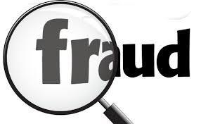
Fraudster's Generic Profile
Scan your team members for following conditions:
Living beyond one's means.
Experiencing financial difficulties.
Unusually close association with vendors/customers.
Excessive work pressure.
Control issues; unwillingness to share duties.
Complaints about pay.
Divorce/family problems.
Irritability, suspiciousness or defensive.
Addiction problems.
Refusal to take vacations.
Enjoy superior's trust.
Prefer to work alone.
Unusually normal person.

Slide 8
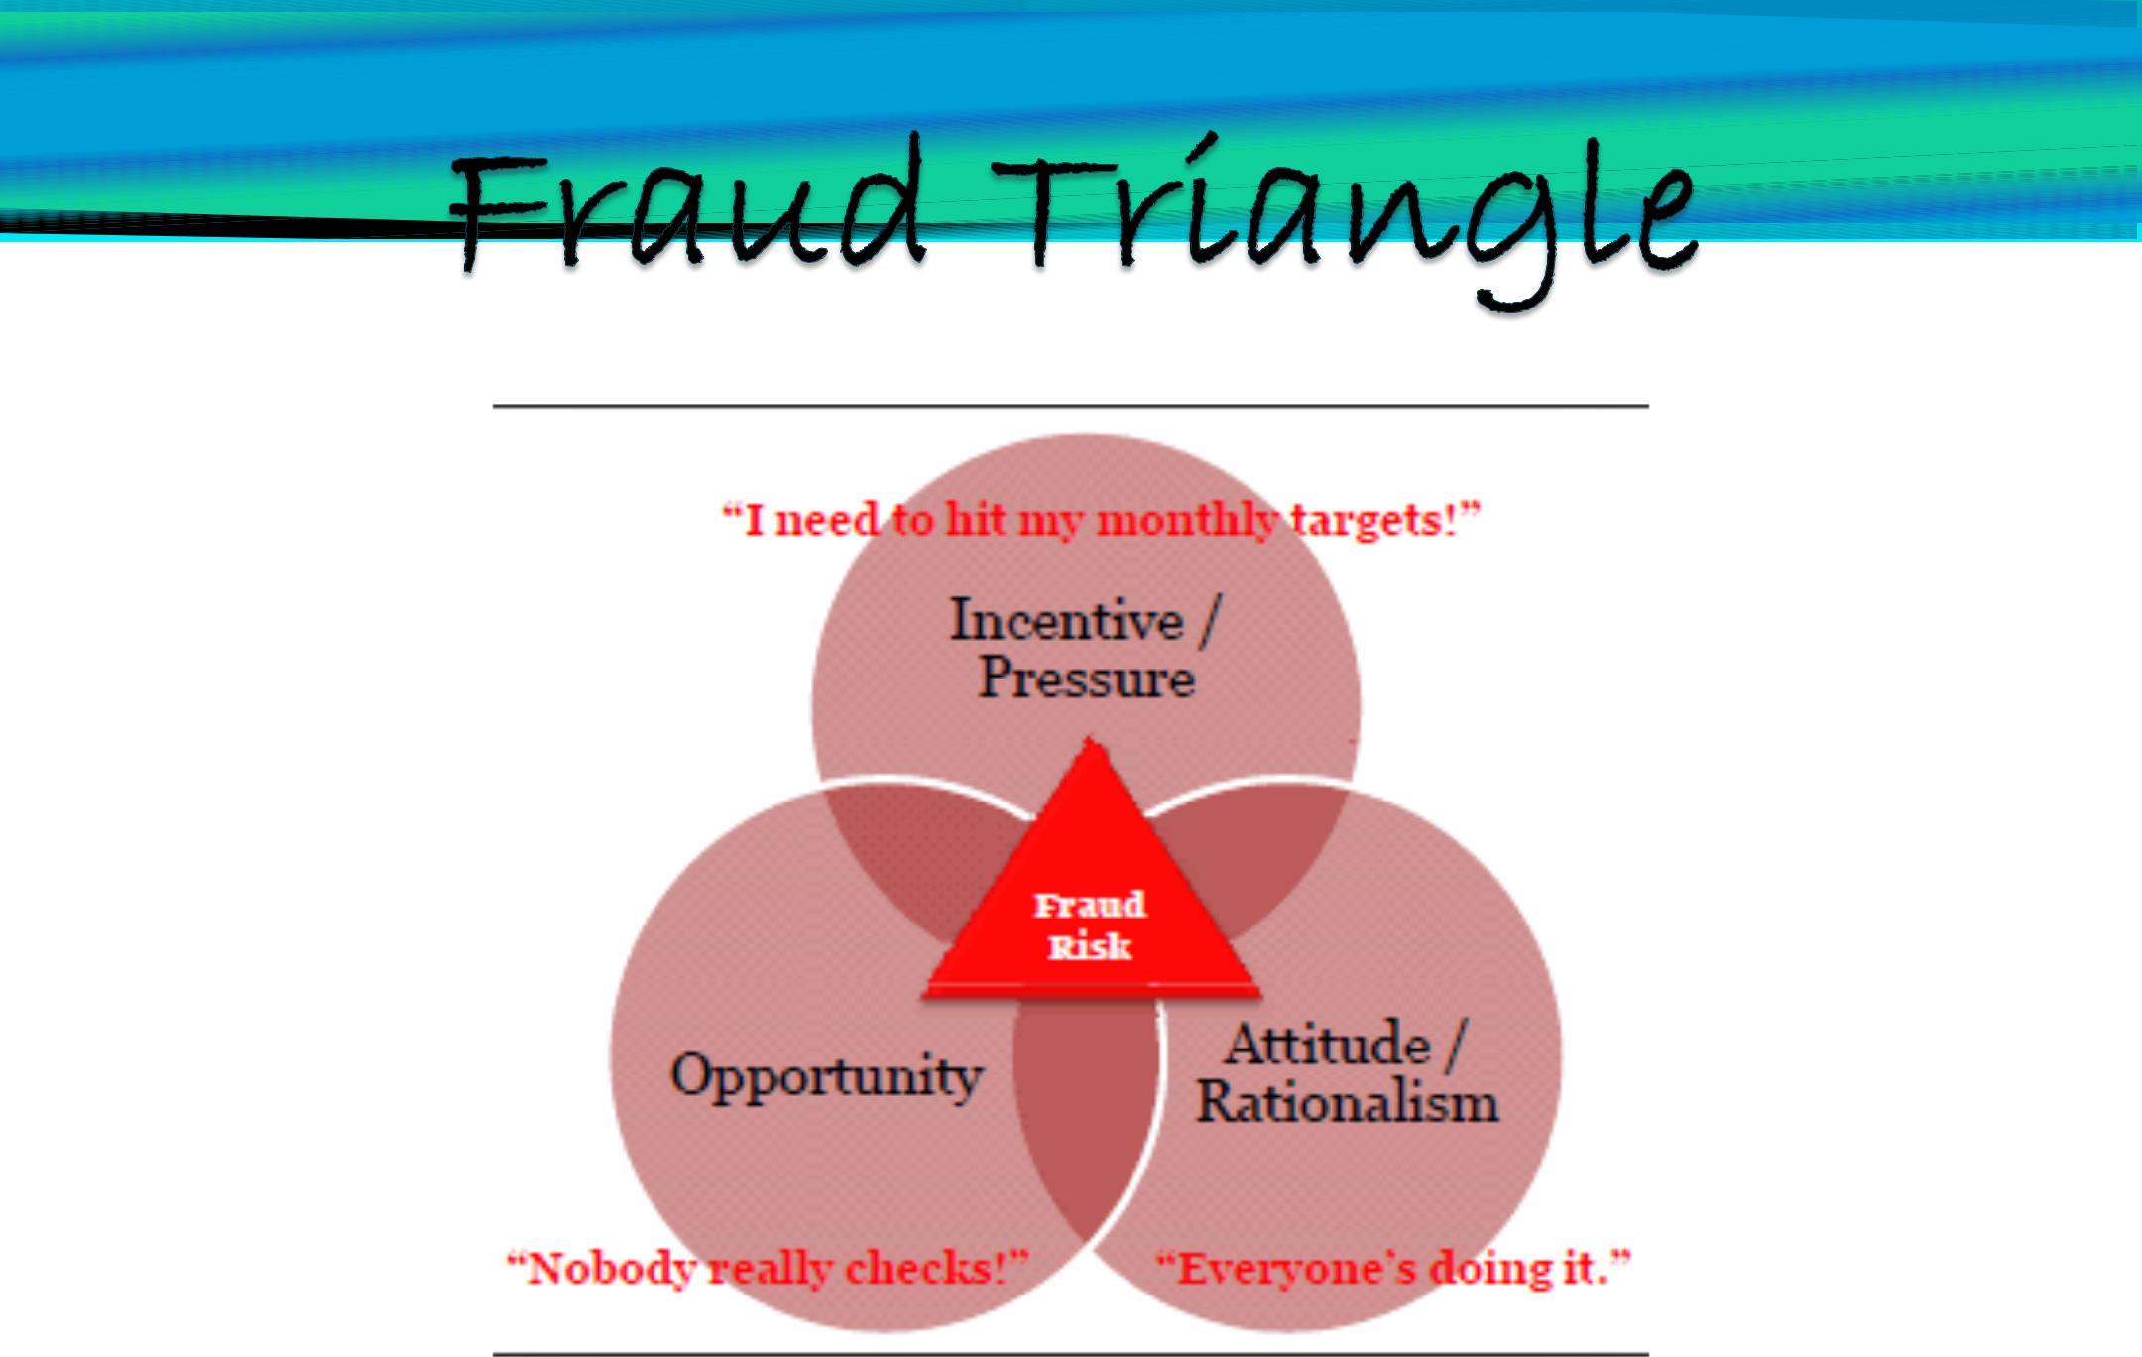
Fraud triangle

Slide 9
Fraud triangle and fraud risk
A fraud triangle is a tool used in forensic auditing that explains three interrelated elements that assist the commission of fraud- Pressure (motive), opportunity (ability to carry out the fraud) and rationalization (justification of dishonest intentions). Fraud risk is the vulnerability a company/organisation has to those who are capable of overcoming the three elements in the fraud triangle. Fraud risk assessment is the identification of fraud risks that exist in the company/organisation. The planning involves the formulation of techniques and procedures that align with the fraud risk and fraud risk management.
Planning also includes the identification of the best way/mode to gather evidence. Thus, it is necessary that ample research is done regarding certain investigative, analytical, and technology-based techniques, and also related legal process, with regard to the outcome of such investigation.

Slide 10
Pressure Factors
Force which makes some one to do some act. Pressure is what causes a person to commit fraud. Desperate people do Desperate things. Pressures comes from many forms as Financial or Non Financial. For instances:
    Repayment of Debt;
    Falling Stock Prices;
    To maintain reputation etc.
Pressure with Financial contents: Such pressures may be long term and short term. These arise when people are in need of cash. These can again be classified as follows:
Itching palm and greediness;
Desire to live well;
High amount of personal debts and health expenditures;
Unexpected financial needs;

Slide 11
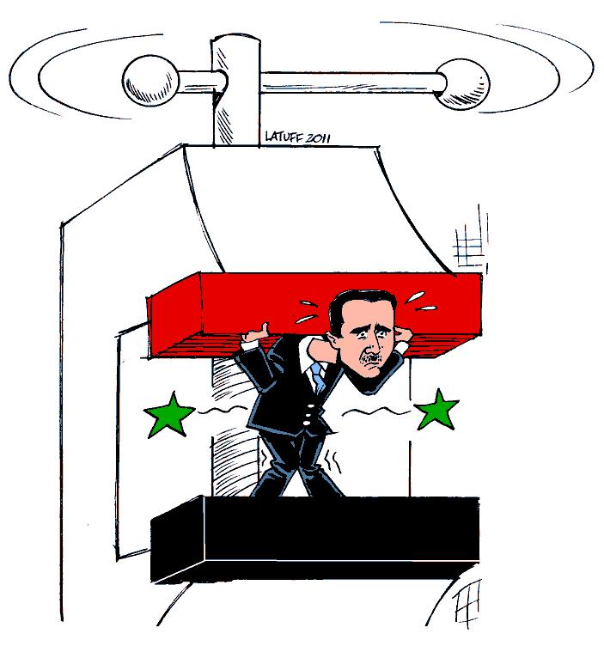
Pressure Factors
Pressure stemming from bad habits:- Such pressures are accepted as the worst kind of factors motivating frauds. The main reasons for such pressures are some attributes related with human qualities. Such attributes are:
Gambling, Drug or alcohol addict;
Night Life habit;
Pressures related with jobs: Such pressures stem from the following:
Being Dissatisfied with the job;
The idea of an unfair attitude;
Not getting promotion when expected;
Lower wages structures;
Not admired by Supervisors.

Slide 12

opportunity Factors
These factors directly involve top management and owners of the business in particular. The control structure of a business and fraud has inverse correlation i.e. Better the control structure; lower the scope of committing fraud and vice versa. The following factors are responsible for providing opportunity to commit frauds.
Weak moral policies;
Undisclosed contracts made with third parties and partners;
In capabilities to assess the quality of job performed by the employees;
Absence of well disciplined environment in which fraudsters will be published;
Ignorance, indifference and inabilities of top management;
Lack of healthy audit work.

Slide 13

Efforts to justify fraud Factors
It is the defence mechanism of fraudsters in order to justify his/her action. The examples include:
I had borrowed the money, I would pay back;
This is in return for my efforts for the business;
Nobody has suffered as a result of this;
I have taken the money for the good purpose;
I didn’t know that this was a crime;
Business has deserved this;
Since business evades tax, I have taken something which was already mine.
In order to prevent all these factors, business should establish moral code and provide employee training.

Slide 14
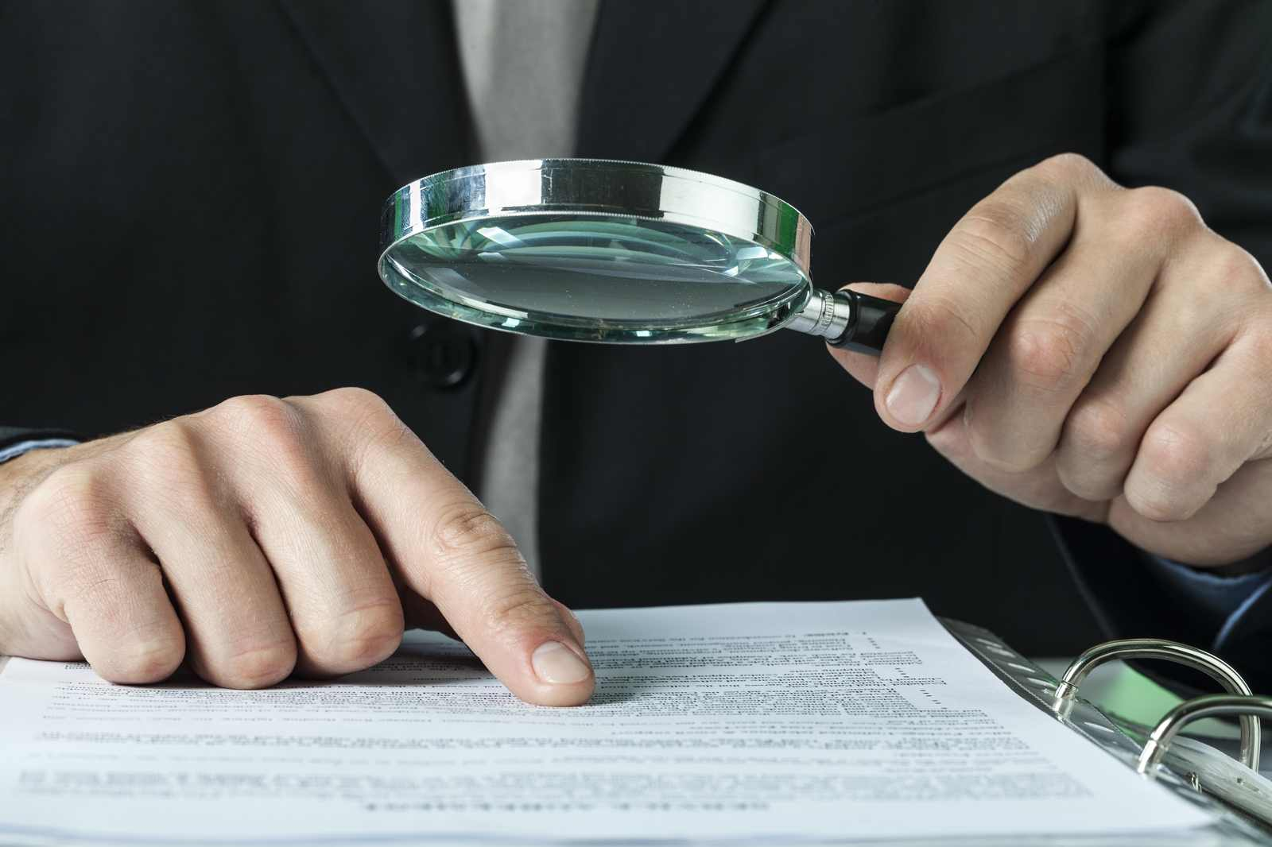
Types of fraud
The forensic accountant could be asked to investigate many different types of fraud. The most common involves theft, including cash, inventory and fraudulent payments. The three categories of frauds are corruption, asset misappropriation and financial statement fraud. They are elaborated in the following slides:

Slide 15
a. corruption
There are three types of corruption frauds: conflicts of interest, bribery, and extortion. Research shows that corruption is involved in around one third of all frauds.
In a conflict of interest fraud, the fraudster exerts his/her influence to achieve a personal gain which detrimentally affects the company. The fraudster may not benefit financially, but rather receives an undisclosed personal benefit as a result of the situation. For example, a manager may approve the expenses of an employee who is also a personal friend in order to maintain that friendship, even if the expenses are inaccurate.
Bribery is when money (or something else of value) is offered in order to influence a situation in one’s favour. For example, Tele smith bribing an employee of Techno smith company to provide certain data to aid Tele smith in preparing a tender offer to Techno smith.
Extortion is the opposite of bribery, and happens when money is demanded (rather than offered) in order to secure a particular outcome.

Slide 16
b. Assets misappropriation
By far the most common frauds are those involving asset misappropriation, and there are many different types of fraud which fall into this category.
The common feature is the theft of cash or other assets from the company, for example:
Cash theft: Misappropriation of cash , the stealing of physical cash, for example petty cash, from the premises of a company.
Fraudulent disbursements: raising fake invoices, company funds being used to make fraudulent payments. Common examples include billing schemes, where payments are made to a fictitious supplier, and payroll schemes, where payments are made to fictitious employees (often known as ‘ghost employees’).
Inventory frauds: the theft of inventory from the company.
Misuse of assets: employees using company assets for their own personal interest.

Slide 17
c. Financial statements fraud
This is also known as fraudulent financial reporting, and is a type of fraud that causes a material misstatement in the financial statements. It can include deliberate falsification of accounting records; omission of transactions– either revenue or expenses, non-disclosure of relevant details from the financial statements, balances or disclosures from the financial statements; or the misapplication of financial reporting standards. This is often carried out with the intention of presenting the financial statements with a particular bias, for example concealing liabilities in order to improve any analysis of liquidity and gearing. Companies get into this type of fraud to try to show the company’s financial performance as better than what it actually is. The goal of presenting fraudulent numbers may be to improve liquidity, ensure top management continue receiving bonuses, or to deal with pressure for market performance.

Slide 18
Procedure for forensic audit investigation
The investigation process is similar to regular audit of financial statements. The forensic auditor should take steps for planning, review and a report. If the investigation is to be conducted to unearth the fraud in respect of purchases, then a complete investigation is to be conducted for due diligence of all the suppliers of the company. This investigation will include verification of the prices at which the goods are supplied by the various suppliers with the prices prevailing in the market from the third party sources. There may be instances of bogus bills being accounted for into the books of accounts without receiving the goods. The forensic auditor has to collect the evidence to unearth the fraud. He will also access the quantum of losses suffered by the company. The findings are presented to the client or the appointing authority.
Thus, the procedure for forensic audit will be changed according to the requirement and type of the forensic audit.
The method for conducting forensic audit are as follows:

Slide 19
Situation oriented procedures
Meeting with the client and accepting the engagement
Performing conflict check
Performing initial investigation
Planning the audit or formation of robust action plan
Gathering relevant evidence
Analysis of evidences and other supporting information
Preparation of Report

Slide 20
1. Accepting the investigation
The forensic accountant must initially consider whether their firm has the necessary skills and experience to accept the work. Forensic investigations are specialist in nature, and the work requires detailed knowledge of fraud investigation techniques and the legal framework. Investigators must also have received training in interview and interrogation techniques, and in how to maintain the safe custody of evidence gathered.
Additional considerations include whether or not the investigation is being requested by an audit client. If it is, this poses extra ethical questions, as the investigating firm would be potentially exposed to self-review, advocacy and management threats to objectivity. Unless robust safeguards are put in place, the firm should not provide audit and forensic investigation services to the same client. Commercial considerations are also important, and a high fee level should be negotiated to compensate for the specialist nature of the work, and the likely involvement of senior and experienced members of the firm in the investigation.

Slide 21
2. planning the investigation
The investigating team must carefully consider what they have been asked to achieve and plan their work accordingly. The objectives of the investigation will include:
Identifying the type of fraud that has been operating, how long it has been operating for, time period during which the fraud has occurred and how the fraud has been concealed;
Identifying the fraudster(s) involved or perpetrators of the fraud;
Quantifying the financial loss suffered by the client;
Gathering evidence to be used in court proceedings;
Providing advice to prevent the reoccurrence of the fraud.

Slide 22
3. Gathering evidence
In order to gather detailed evidence, the investigator must understand the specific type of fraud that has been carried out, and how the fraud has been committed. The evidence should be sufficient to ultimately prove the identity of the fraudster(s), the mechanics of the fraud scheme, and the amount of financial loss suffered. It is important that the investigating team is skilled in collecting evidence that can be used in a court case, and in keeping a clear chain of custody until the evidence is presented in court. If any evidence is inconclusive or there are gaps in the chain of custody, then the evidence may be challenged in court, or even become inadmissible. Investigators must be alert to documents being falsified, damaged or destroyed by the suspect(s). Common techniques used for collecting evidence in a forensic audit include the following:
Testing controls to gather evidence which identifies the weaknesses, which allowed the fraud to be perpetrated;
Using analytical procedures to compare trends over time or to provide comparatives between different segments of the business;

Slide 23
3. Gathering evidence…. (Cont.)
Applying computer assisted audit techniques, for example to identify the timing and location of relevant details being altered in the computer system;
Discussions and interviews with employees or suspect(s);
Understanding internal controls and testing them so as to understand the loopholes which allowed the fraud to be perpetrated;
Substantive techniques such as reconciliations, cash counts and reviews of documentation.
The ultimate goal of the forensic investigation team is to obtain a confession by the fraudster, if a fraud did actually occur. For this reason, the investigators are likely to avoid deliberately confronting the alleged fraudster(s) until they have gathered sufficient evidence to extract a confession. The interview with the suspect is a crucial part of evidence gathered during the investigation.

Slide 24
4. Forensic data analysis (fda)
FDA is the technology used to conduct fraud investigations; the process by which evidence is gathered, summarized and compared with existing different sets of data. The aim here is to detect any anomalies in the data and identify the pattern of such anomalies to indicate fraudulent activity. Such an analysis requires three kinds of expertise,
Data analyst to perform the technical steps and write the queries
Team member with extensive experience of the processes and internal controls in the relevant area of the investigated company
A forensic scientist who is familiar with patterns of fraudulent behaviour.

Slide 25
5. reporting
The client will expect a report containing the findings of the investigation, including a summary of evidence and a conclusion as to the amount of loss suffered as a result of the fraud. The report will also discuss how the fraudster set up the fraud scheme, and which controls, if any, were circumvented basically the whole trail of events. It is also likely that the investigative team will recommend improvements to controls within the organisation to prevent any similar frauds occurring in the future.

Slide 26
6. Court proceedings
The investigation is likely to lead to legal proceedings against the suspect, and members of the investigative team will probably be involved in any resultant court case. The evidence gathered during the investigation will be presented at court, and team members may be called to court to describe the evidence they have gathered and to explain how the suspect was identified. It is imperative that the members of the investigative team called to court can present their evidence clearly and professionally, as they may have to simplify complex accounting issues so that non-accountants involved in the court case can understand the evidence and its implications.

Slide 27
Systems of fraud
Delayed submission of returns information etc;
Delayed remittances into Bank;
Delay or non preparation of Bank reconciliation statements;
Lifestyle of promoters/ directors and key employees;
Continued internal control lapses and not following norms of corporate governance.
INTERNAL INDICATORS
Delay in finalisation of accounts;
Frequent changes in accounting policies;
Continuing losses;
Over drawl of loans and advances;
Higher cost per unit of production
High amount of losses or wastage shown in books vs. norms;
High investment in group companies;
Profit not supported by increased cash availability.

Slide 28
POSSIBLE AREAS WHERE FROUD CAN BE COMMITTED IN CORPORATE SECTORS
Misappropriation of cash by fudging accounts;
Raising huge amount of term loan from banks and financial institution by means of inflating the project cost by over invoicing the plant & machinery and components purchased for setting up the project and then diverting of inflated amount for non business use;
Raising of excess working capital loan from banks by over valuing the inventory and booking of bogus expenses etc. and diversion of funds for personal gains;
Using inter branch transaction for creation of fictious entries by rotation of cheques for raising equity capital of a company without bringing any money in the company.

Slide 29
POSSIBLE AREAS WHERE FROUD CAN BE COMMITTED IN CORPORATE SECTORS…(cont.)
Fictious capital raised by the companies in the above manner are used showing them as promoters contribution in order to raise loans from banks and financial institutions;
Share certificates issued on basis of such fictitiously created equity capital are also sold to the public at a highly jacked-up price for making money in fraudulent manner from share market;
Raising of fictitious bills of sale and purchase by doing circular trading entries of sales and purchases among group companies without movement of goods and using such bills for discounting with banks for collecting funds from the banks.;
Misappropriation of the funds provided by banks on discounting of export bills issued in the name of foreign buyers under disguise.

Slide 30
POSSIBLE AREAS WHERE FROUD CAN BE COMMITTED IN CORPORATE SECTORS…(cont.)
Falsification of annual accounts of the companies to show inflated turnover as well as inflated profits and in this way declaring good working results to stakeholders as well as bank in order to mislead them for attracting more investment from public and credit facilities from banks;
Accounts are also falsified to conceal true results of operations, or financial position of the company with a view to prevent timely detection of corporate frauds.
Cheating in foreign exchange transaction by showing as fictious exports;

Slide 31
POSSIBLE AREAS WHERE FROUD CAN BE COMMITTED IN CORPORATE SECTORS…(cont.)
Floating of many companies/ firms on paper without any significant business and using various bank accounts opened in the names of these companies to misappropriate funds diverted to them from the credit facility availed from bank as well as investments received from public;
Generally employees of the main company (indulging into fraudulent activities) are shown as directors/partners of such companies/firms (used for diverting the fund received from public and banks) and they do not know any of the affairs of these companies/ firms except signing of the cheques issued by these companies/firms;

Slide 32
Modus - operandi
Loans & Advances
Fake CA Certificates/ Financial Statements;
Bogus Invoices/quotations/ bills;
Fraudulent removal of stocks charged;
Inflated valuations of securities;
Fake forged property documents;
Fake/Wrong search Reports;
Diversion of funds through bogus sisters concerns;
Deposits / miscellaneous areas;
Un-authorised loans against deposits/ NRI deposits;
ATM Frauds by stealing PINs/interception of cards;
Encashment of stolen/forged financial instruments through fictious accounts;
Misuse of other’s passwords for misappropriation of funds

Slide 33

How can you reduce liability and instances of fraud?
The increasing instances of white collar crimes in India stem out of two basic ideas of greed and an attitude of “not a crime”. Thus, the courts take a strict view of such instances to decide on such matters and eradicate the rising rates of such crimes, which are also a major hindrance to the growing state of the economy. In order to decrease the possibility of such crimes, and also eventually reduce liability, companies can keep the following points in mind for mitigating fraud risk.

Slide 34
How can you reduce liability and instances of fraud?
…(Cont.)
It is highly recommended that companies harbour a “stop before it starts policy” by creating a transparent working environment.
Employ teams to conduct a frequent analysis of the fraud triangle keeping in view the working atmosphere in the company.
Come up with policies to work on the ‘rationalisation’ aspect of the fraud triangle to strike at the root of the problem.
Follow a dynamic approach while defining fraud in the company transactions keeping in mind the ongoing scenario of white collar crimes.
The institution of strong internal controls and anti-fraud technologies in the electronic platform.
Thorough and frequent evaluation of the company’s code of conduct.

Slide 35
Difference between forensic audit and statutory audit
S. No | Basis | Statutory Audit | Forensic Audit
1. | Objective | To express opinion as to ‘true & fair’ presentation. | To determine correctness of the accounts or whether any fraud has actually taken place.
2. | Techniques | ‘Substantive’ and ‘compliance’ procedures. | Analysis of past trend and substantive or ‘in depth’ checking of selected transactions are done.
3. | Period | Normally all transactions for the particular accounting period are considered. | There is no such limitations while conducting forensic audit and accounts may be examined in detail from the beginning.

Slide 36
Difference between forensic audit and statutory audit
SI. No. | Basis | Statutory Audit | Forensic Audit
4. | Management Representation | Auditor relies on the management certificate/representation of management. | Independent verification of suspected/selected items carried out
5. | Off balance-sheet items (like contracts etc.): | Off balance-sheet items are used to vouch the arithmetic accuracy & compliance with procedures. | Regularity and propriety of these transactions/contracts are examined.
6. | Adverse findings, if any | If there are any adverse findings, negative opinion or qualified opinion is expressed, with/without quantification. | The auditor aims at legal determination of fraud and also naming persons behind such fraud.

Slide 37
Preparation of Report
The report generally includes various sections describing the nature of assignment, scope, approaches utilized, findings, opinion and limitations. Report is generally submitted to the Appointing Authority.
The contents of the report may vary depending upon the situation, the nature and the extent of the frauds and irregularities involved. The generalized form of such forensic accounting investigation report is as follows:

Slide 38
Preparation of Report…(cont.)
TITLE OF THE REPORT
EXECUTIVE SUMMARY
BACKGROUND OF ENGAGEMENT
3.1. Origin
3.2. Objectives of Engagement
3.3. Proposed outputs of the Assignments
3.4. Implementation Approaches
4. ANALYSIS OF THE RISKS INVOLVED
4.1. Internal Environment Risks
4.2. External Environment Risks
4.3. Political and Legal Scenario
4.4. Risks from Customers, Suppliers and Competitors etc.
4.5 Business Process and Human Resources Management
4.6. Market, Operational and Technological Risks
4.7. Others

Slide 39
Preparation of Report…(cont.)
5. EVIDENCE OF RISK EVENTS
6. ANALYSIS and FINDINGS
7. AUDIT RECOMMENDATIONS
7.1. Logical Framework Approach
7.2. Preconditions and Risks
8. IMPLEMENTATION OF RECOMMENDATIONS
8.1. Budget Considerations
8.2. Stakeholders to be Engaged
9. LIST OF ANNEXURES

Slide 40
Conclusion
In summary, a forensic investigation is a very specialised and detailed type of engagement, which requires highly skilled team members who have experience not only of accounting and auditing techniques, but also of the relevant legal framework. There are numerous different types of fraud that a forensic accountant could be asked to investigate. The investigation is likely to ultimately lead to legal proceedings against one or several suspects, and members of the investigative team must be comfortable with appearing in court to explain how the investigation was conducted, and how the evidence has been gathered. Forensic accountants must therefore receive specialist training in such matters to ensure that their credibility and professionalism cannot be undermined during the legal process.

Slide 41
THANK YOU
BHATIA & BHATIA
CHARTERED ACCOUNTANTS

